Slide 1
Natural Images - Kaggle
Khajan Joshi
Natural Images
1

Slide 2
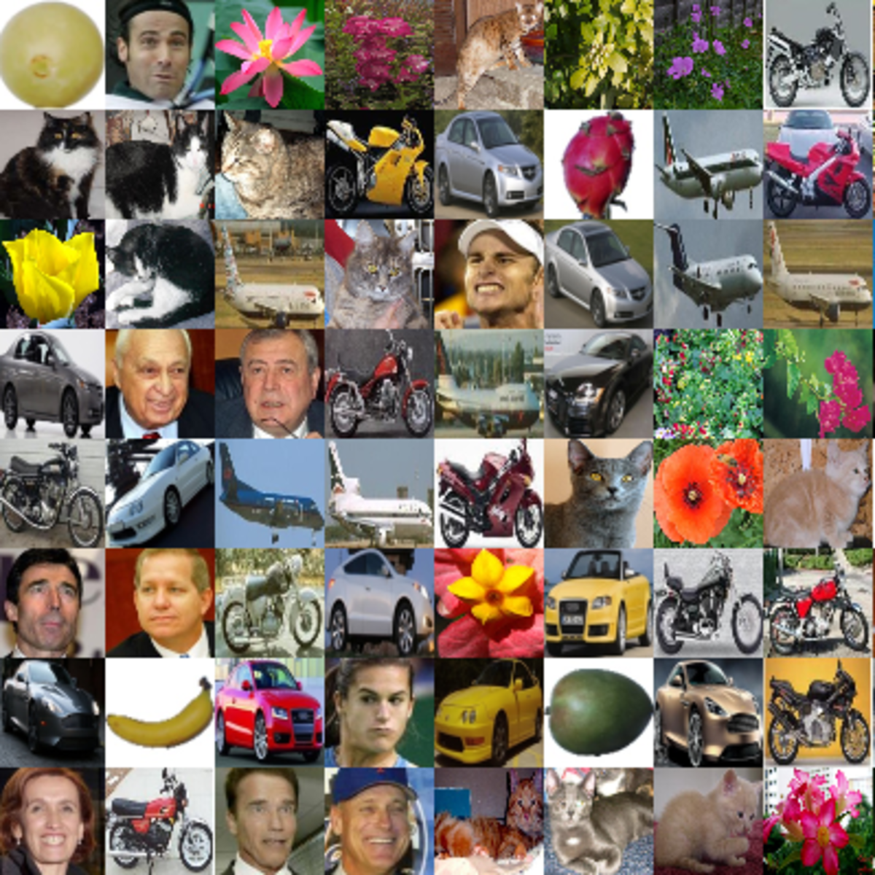
Understanding the dataset
This dataset contains 6899 images
The images are from 8 classes
The classes include airplane, car, cat, dog, flower, fruit, motorbike and person
Natural Images Dataset from Kaggle
Natural Images
2

Slide 3
What is the expectation?
Train a machine learning model which can predict the class of new and unseen data/images
Implement the various machine learning techniques
Provide evaluation of the implementations
Natural Images Dataset from Kaggle
Natural Images
3

Slide 4
Machine Learning Model
I will be using a convolutional neural network (CNN) for predicting the images from the Natural Images dataset.
This is because CNNs are known to perform very well for images and the use of convolution layers with filters helps the model identify features and make predictions
For the preprocessing, I will be using VGG16, which is a very successful image classification model. The VGG16 architecture has series of convolution layers and max pooing layers.
After trying multiple model architectures by trail and error, hyperparameter tuning and model comparisons from ensembles, using a 2 layer VGG16 model gives the best accuracy and generalizes well on the test set, for the natural images dataset from kaggle.
Natural Images
4

Slide 5
Jupyter Notebook Contents
Importing packages
Organizing and preprocessing data
First CNN model
Hyperparameter tuning with small dataset
Creating ensembles
Data augmentation
Natural Images
5

Slide 6
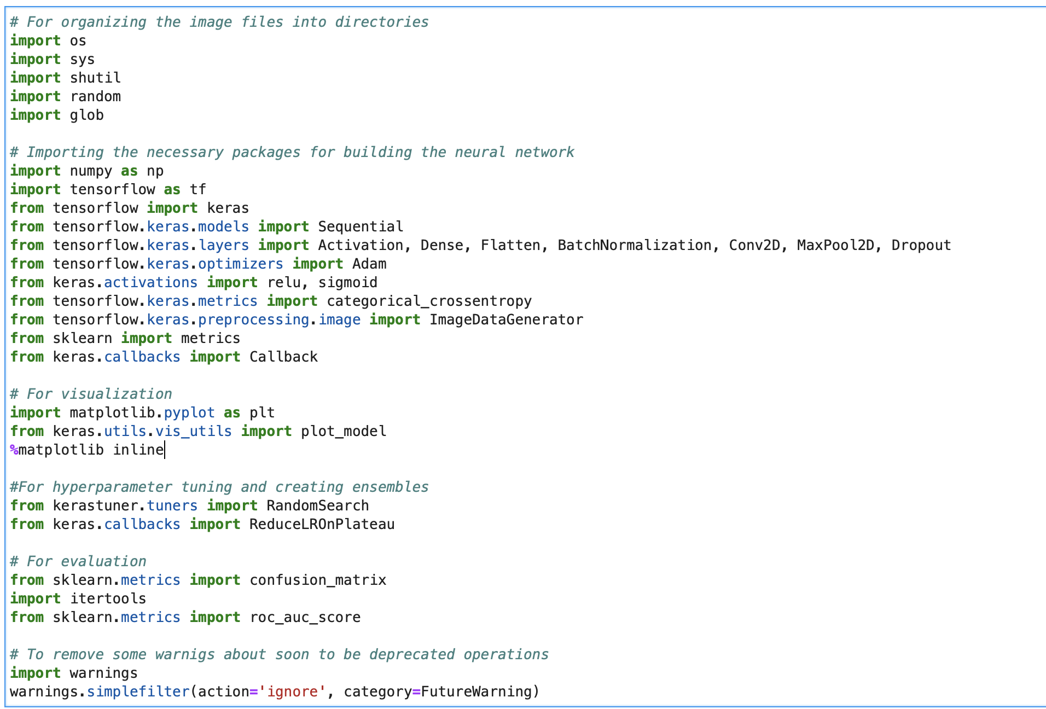
Importing Packages
For organizing the data, I will be importing some packages which will help in moving files from one directory to another, as well as providing information of directory contents, which will then be used for visualizing the data.
I will also import the required packages for building a CNN
Then I have imported packages for visualization, hyperparameter tuning and model evaluation
Finally, I have imported the warnings package, in order to ignore display of few errors which will not affect this notebook currently
Natural Images
6

Slide 7
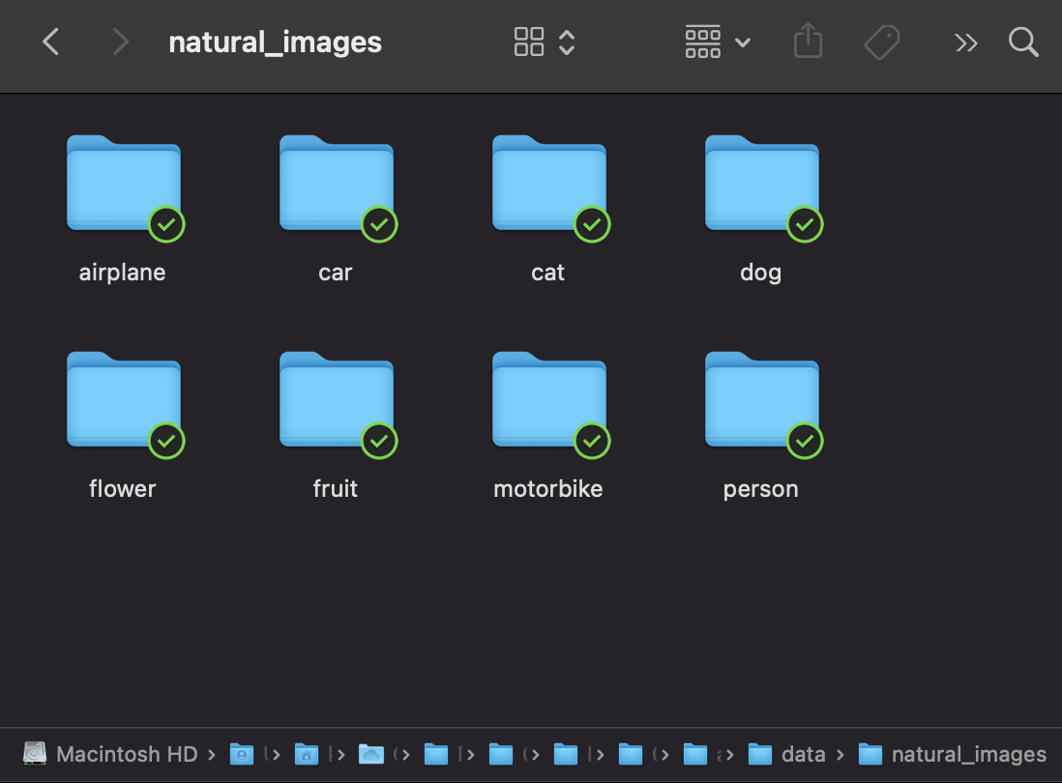
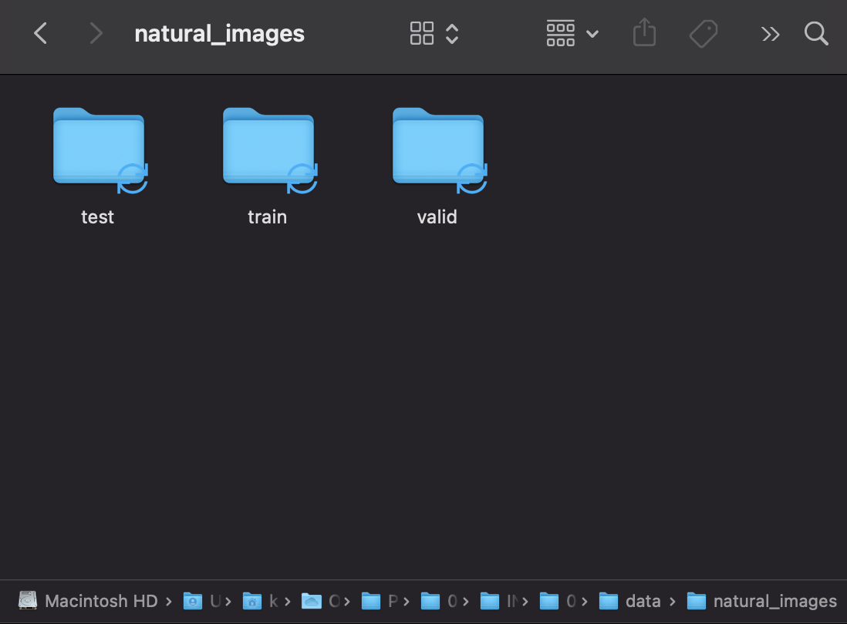
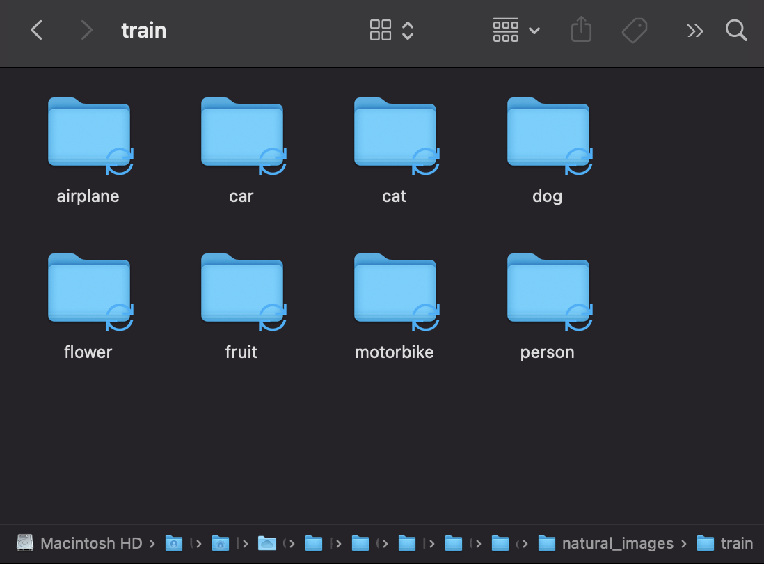
Organizing and preprocessing data
When the dataset is downloaded from Kaggle, the images are in the following structure: data>>natural_images>>(class)>>image
Before building the model, the images are placed in the following structure: data>>natural_images>>train>>(class)>>image – for images in train set. Similarly, for valid and test
Natural Images
7

Slide 8
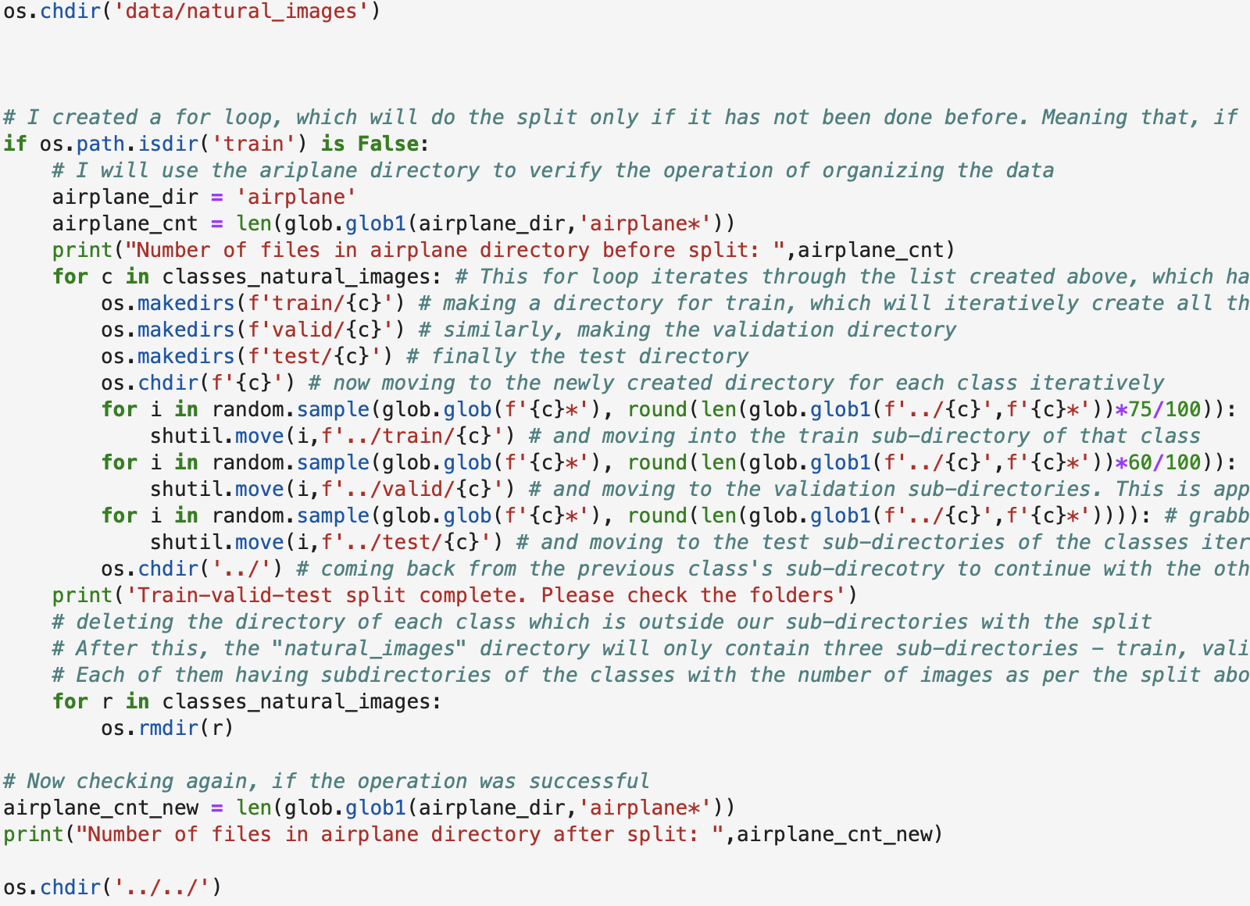
Organizing and preprocessing data
This cell of the notebook does the operation of moving image files to the directories as mentioned in the previous slide
os.chdir() – changes directory of the kernel to the specified location
os.makedirs() – creates a specified directory
glob – used for grabbing files
shutil.move() – moves files to the specified directory
os.rmdir() – deletes an empty directory
shutil.rmtree() – deletes a directory and it’s contents
Natural Images
8

Slide 9
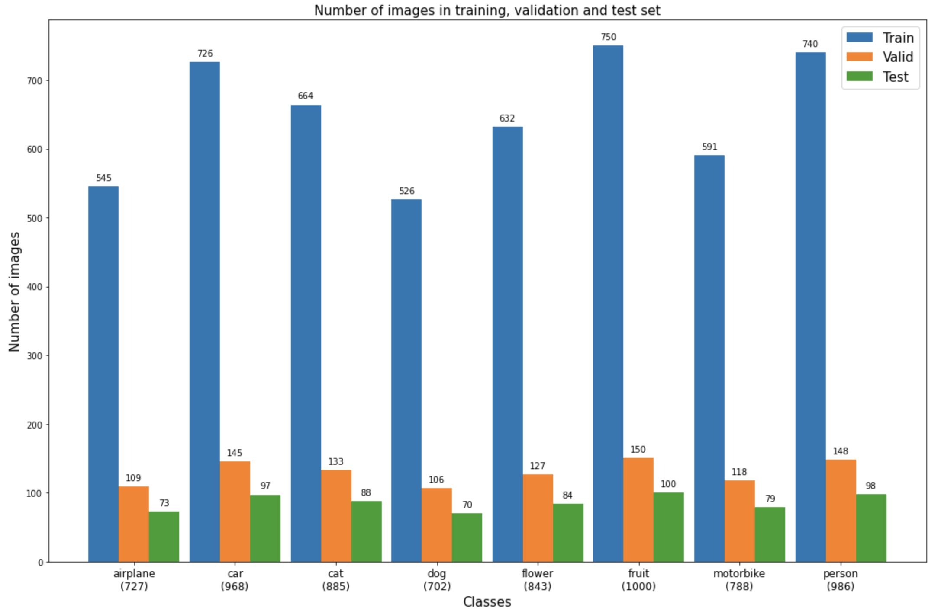
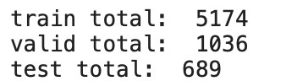
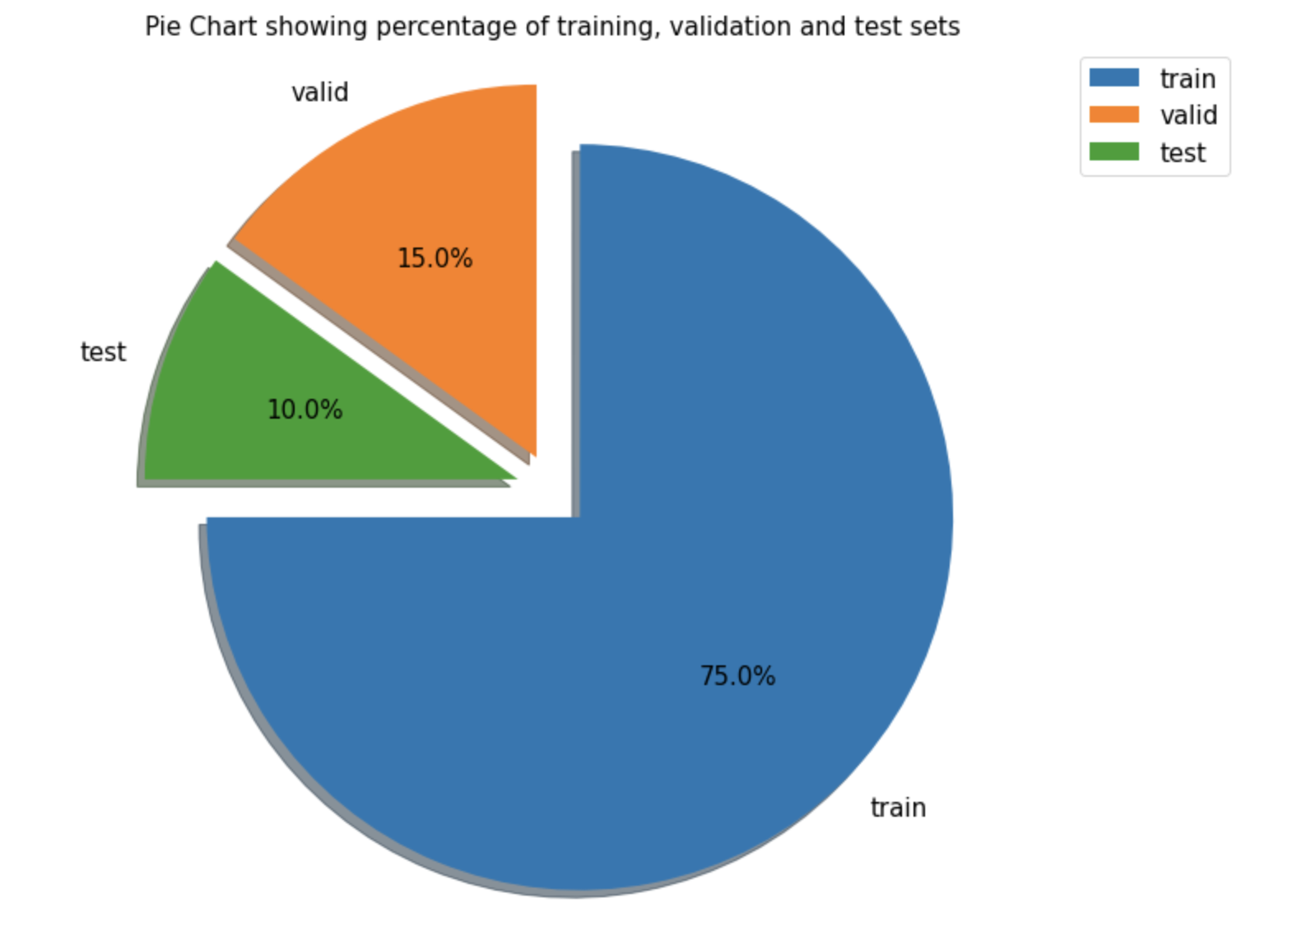
Organizing and preprocessing data
Here we can see the number of images for each of the 8 classes for the train, valid and test sets as per the code in the previous slide
The split is:
75% for training
15% for validation
10% for testing
Natural Images
9

Slide 10
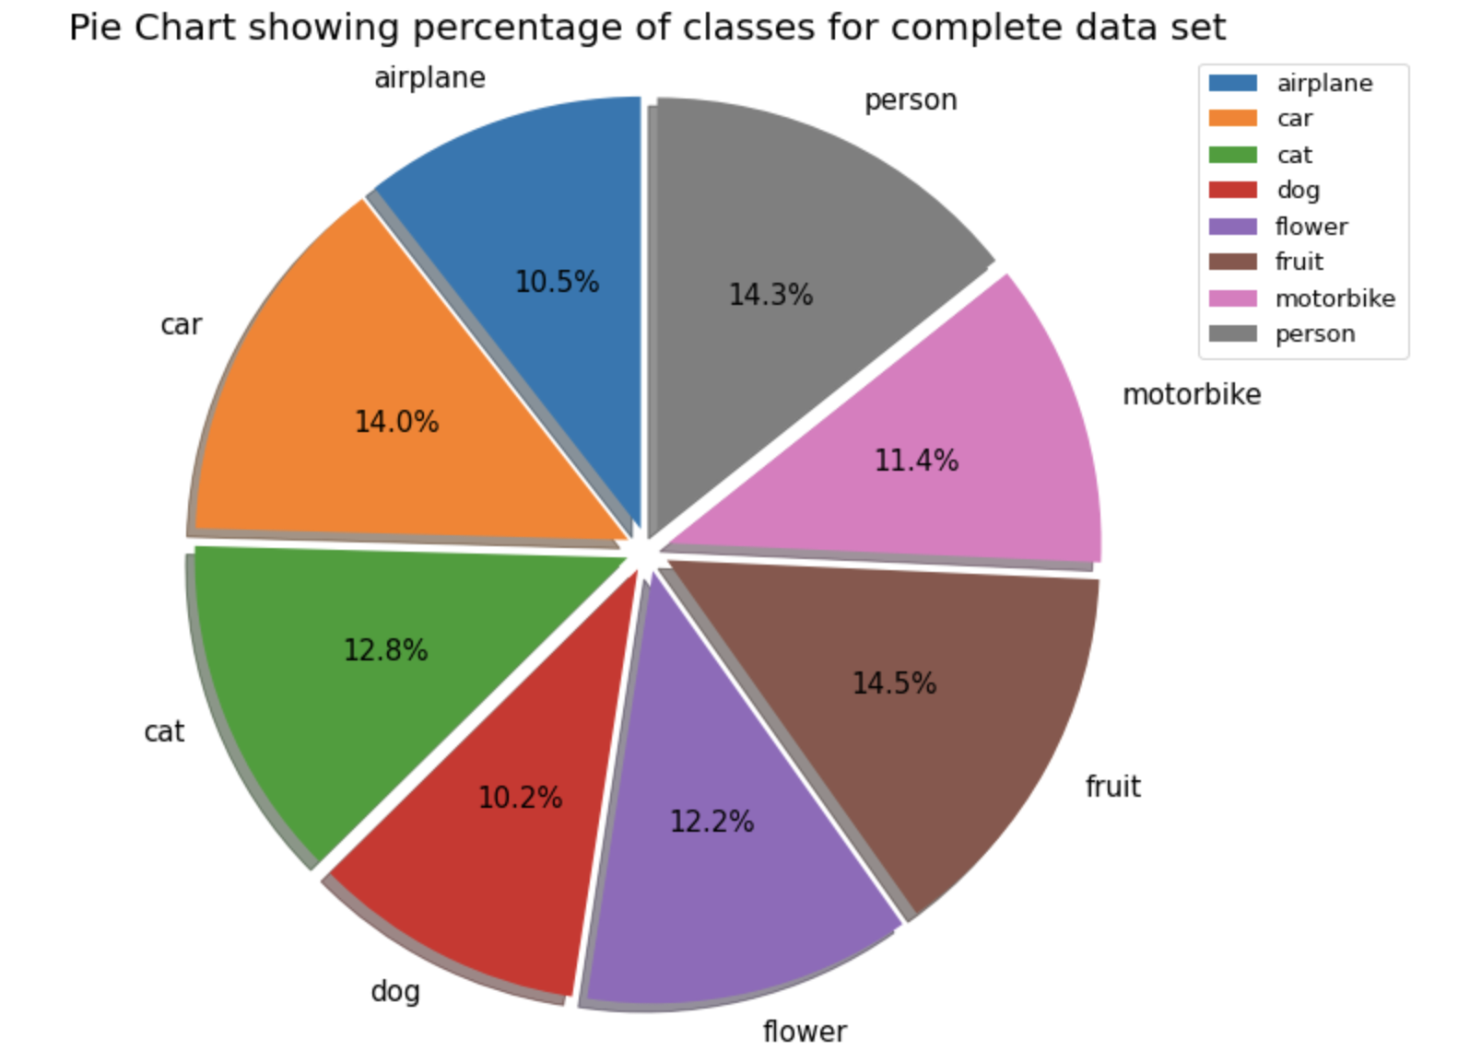
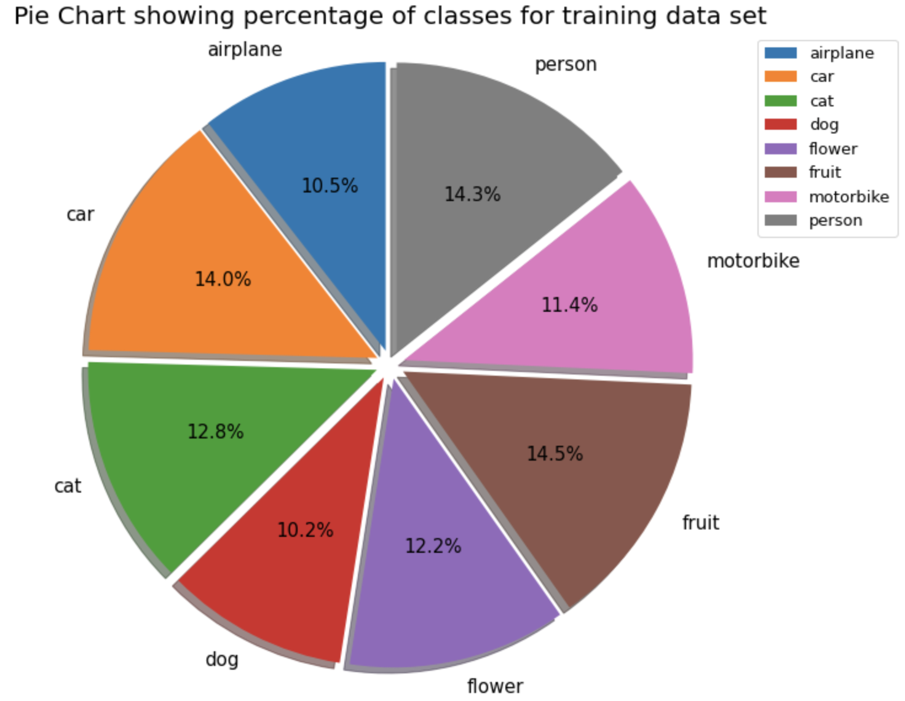
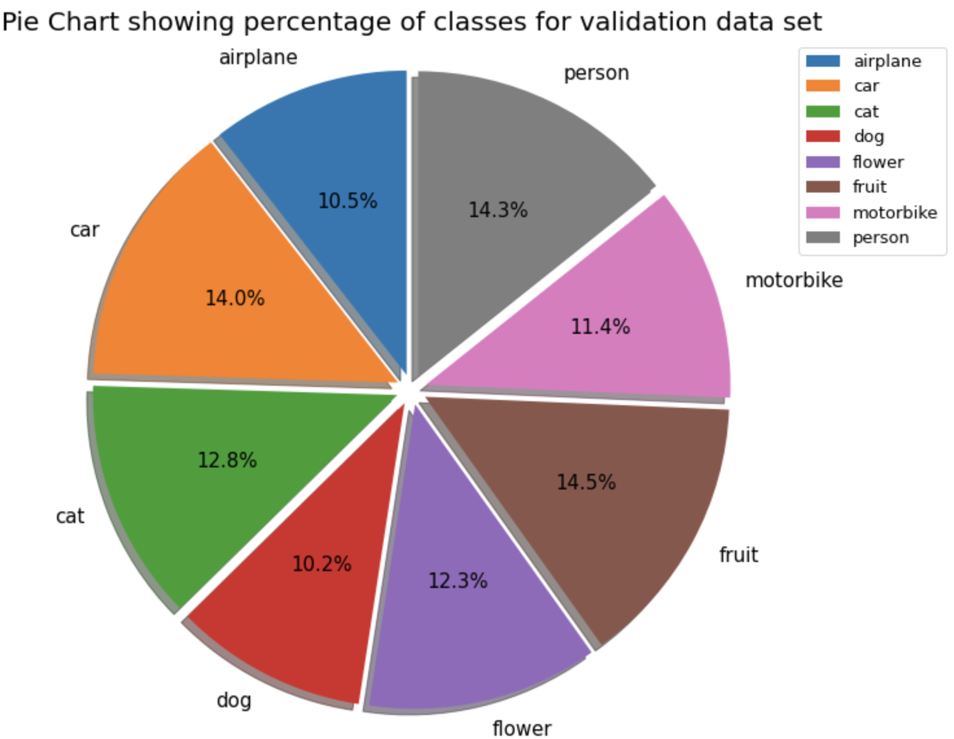
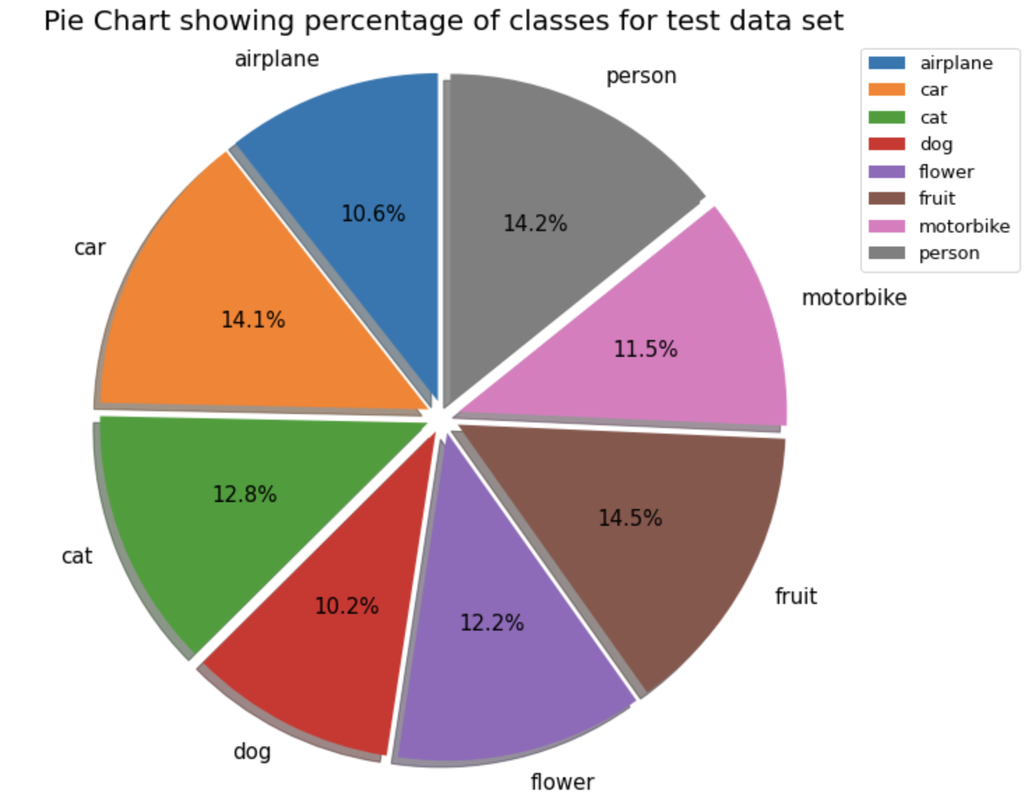
Organizing and preprocessing data
The classes are quite balanced as we can see in this pie-chart as seen on the left
The balance between classes was kept almost similar after the split as seen below
Natural Images
10

Slide 11
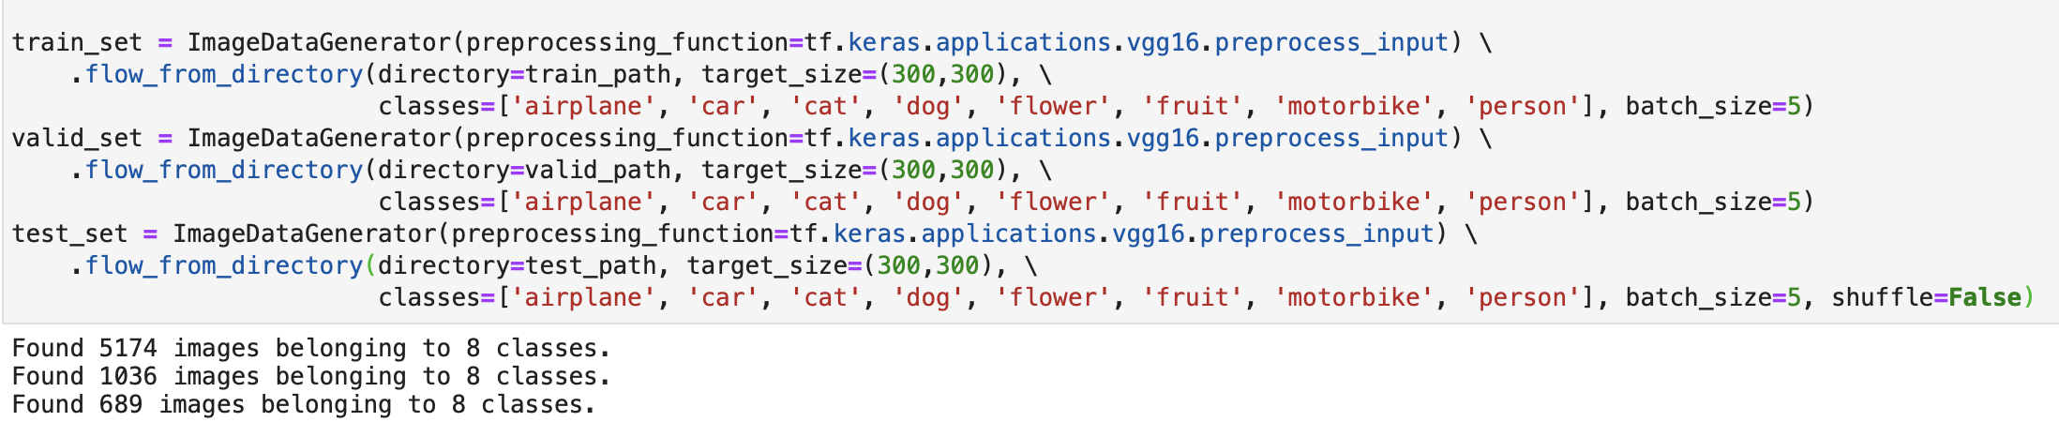
Organizing and preprocessing data
In the above cell, the ImageDataGenerator class from Keras generates batches of tensor image data and flow_from_directory takes a path to a directory. The target size is the height and width of the tuple of integers of the image data. (300,300) are the dimensions these images will be resized to. The default is (256,256). Classes is the list of classes. Batch size is the size of the batches of data (default 32). Shuffling is done only for the train and valid sets.
For the preprocessing function, I have selected vgg16.preprocess_input which converts the images from RGB to BGR and the color channel is zero-centered with respect to the ImageNet dataset. More details are provided in the notebook.
Natural Images
11

Slide 12
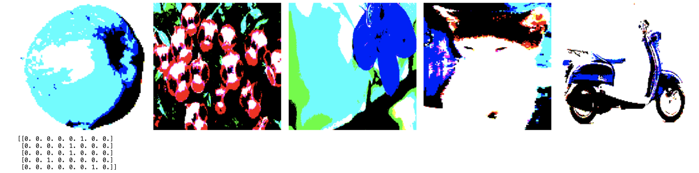
Organizing and preprocessing data
This is what the preprocessed images look like for the train set. The image color is off due to the VGG16 pre-processing as mentioned in the previous slide. The classes are one-hot encoded.
[1. 0. 0. 0. 0. 0. 0. 0.] is for airplane
[0. 1. 0. 0. 0. 0. 0. 0.] is for car
[0. 0. 1. 0. 0. 0. 0. 0.] is for cat
[0. 0. 0. 1. 0. 0. 0. 0.] is for dog
[0. 0. 0. 0. 1. 0. 0. 0.] is for flower
[0. 0. 0. 0. 0. 1. 0. 0.] is for fruit
[0. 0. 0. 0. 0. 0. 1. 0.] is for motorbike
[0. 0. 0. 0. 0. 0. 0. 1.] is for person
Natural Images
12

Slide 13
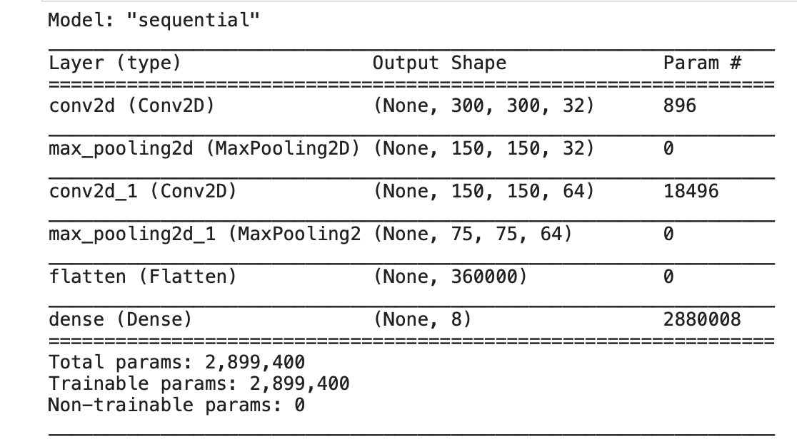
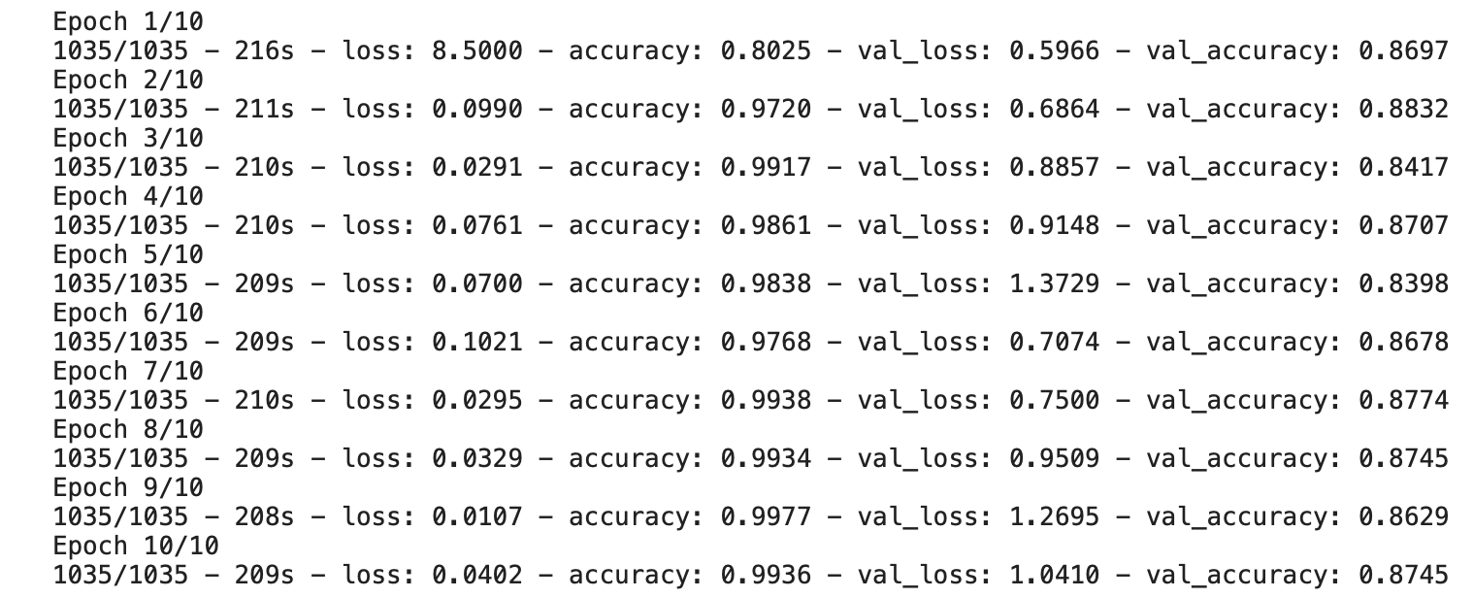
First CNN model
This is the architecture of the initial model I have built.
It is a typical 2 layer VGG16 architecture with a Conv2D layer followed by a max pooling layer.
Finally it is flattened followed by a Dense function for the 8 classes.
The model is compiled with adam optimizer with learning rate of 0.0001,
loss function – categorical_crossentropy and the metric is “accuracy”.
The model is then fit with the train set for 10 epochs as shown in the image above
Natural Images
13

Slide 14
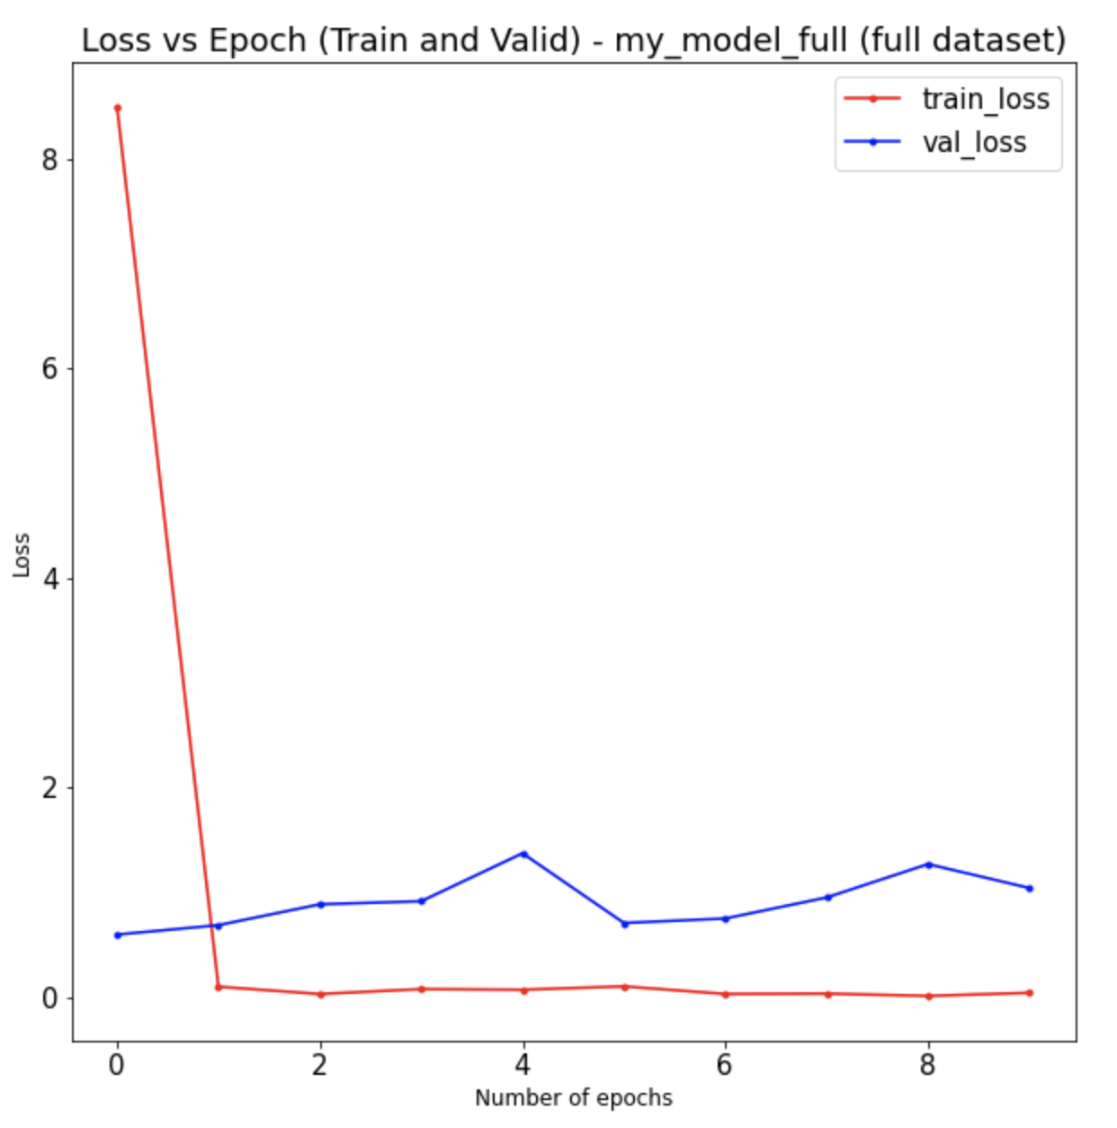
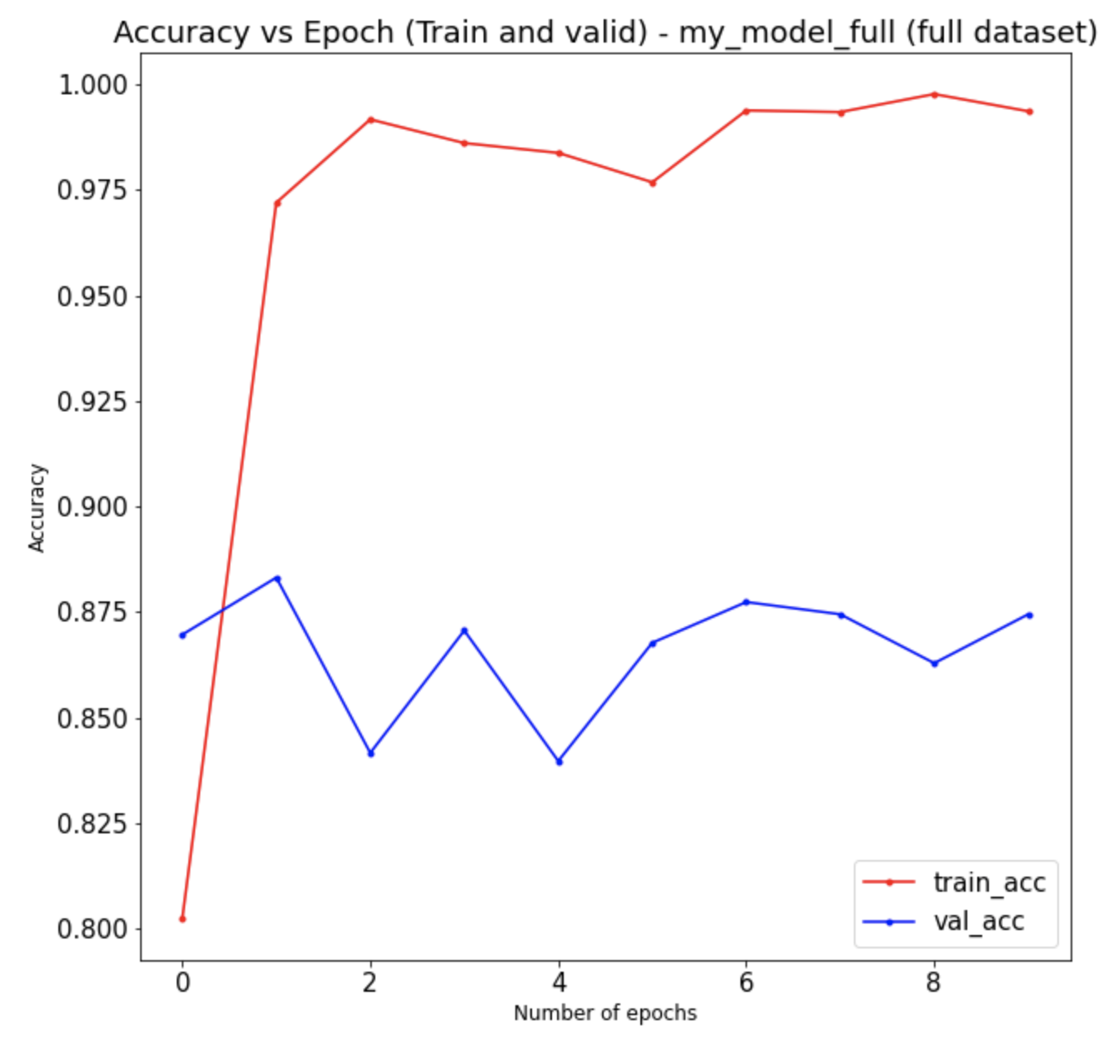
First CNN model
The above graph shows the Loss vs Number of epochs for the training and validation sets
We can see that the training loss very less. Even the validation loss is quite low
The above graph shows the Accuracy vs Number of epochs for the training and validation sets
We can see that the training accuracy is close to 100%. The validation accuracy is between 85% to 90%. So there is some over-fitting
Natural Images
14

Slide 15
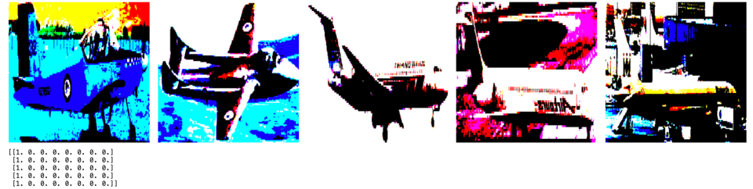
First CNN model
This is what the preprocessed images look like for the test set. The image color is off due to the VGG16 pre-processing as mentioned previously. The dataset is not shuffled as we can see in this first batch. The classes are one-hot encoded.
[1. 0. 0. 0. 0. 0. 0. 0.] is for airplane
[0. 1. 0. 0. 0. 0. 0. 0.] is for car
[0. 0. 1. 0. 0. 0. 0. 0.] is for cat
[0. 0. 0. 1. 0. 0. 0. 0.] is for dog
[0. 0. 0. 0. 1. 0. 0. 0.] is for flower
[0. 0. 0. 0. 0. 1. 0. 0.] is for fruit
[0. 0. 0. 0. 0. 0. 1. 0.] is for motorbike
[0. 0. 0. 0. 0. 0. 0. 1.] is for person
Natural Images
15

Slide 16
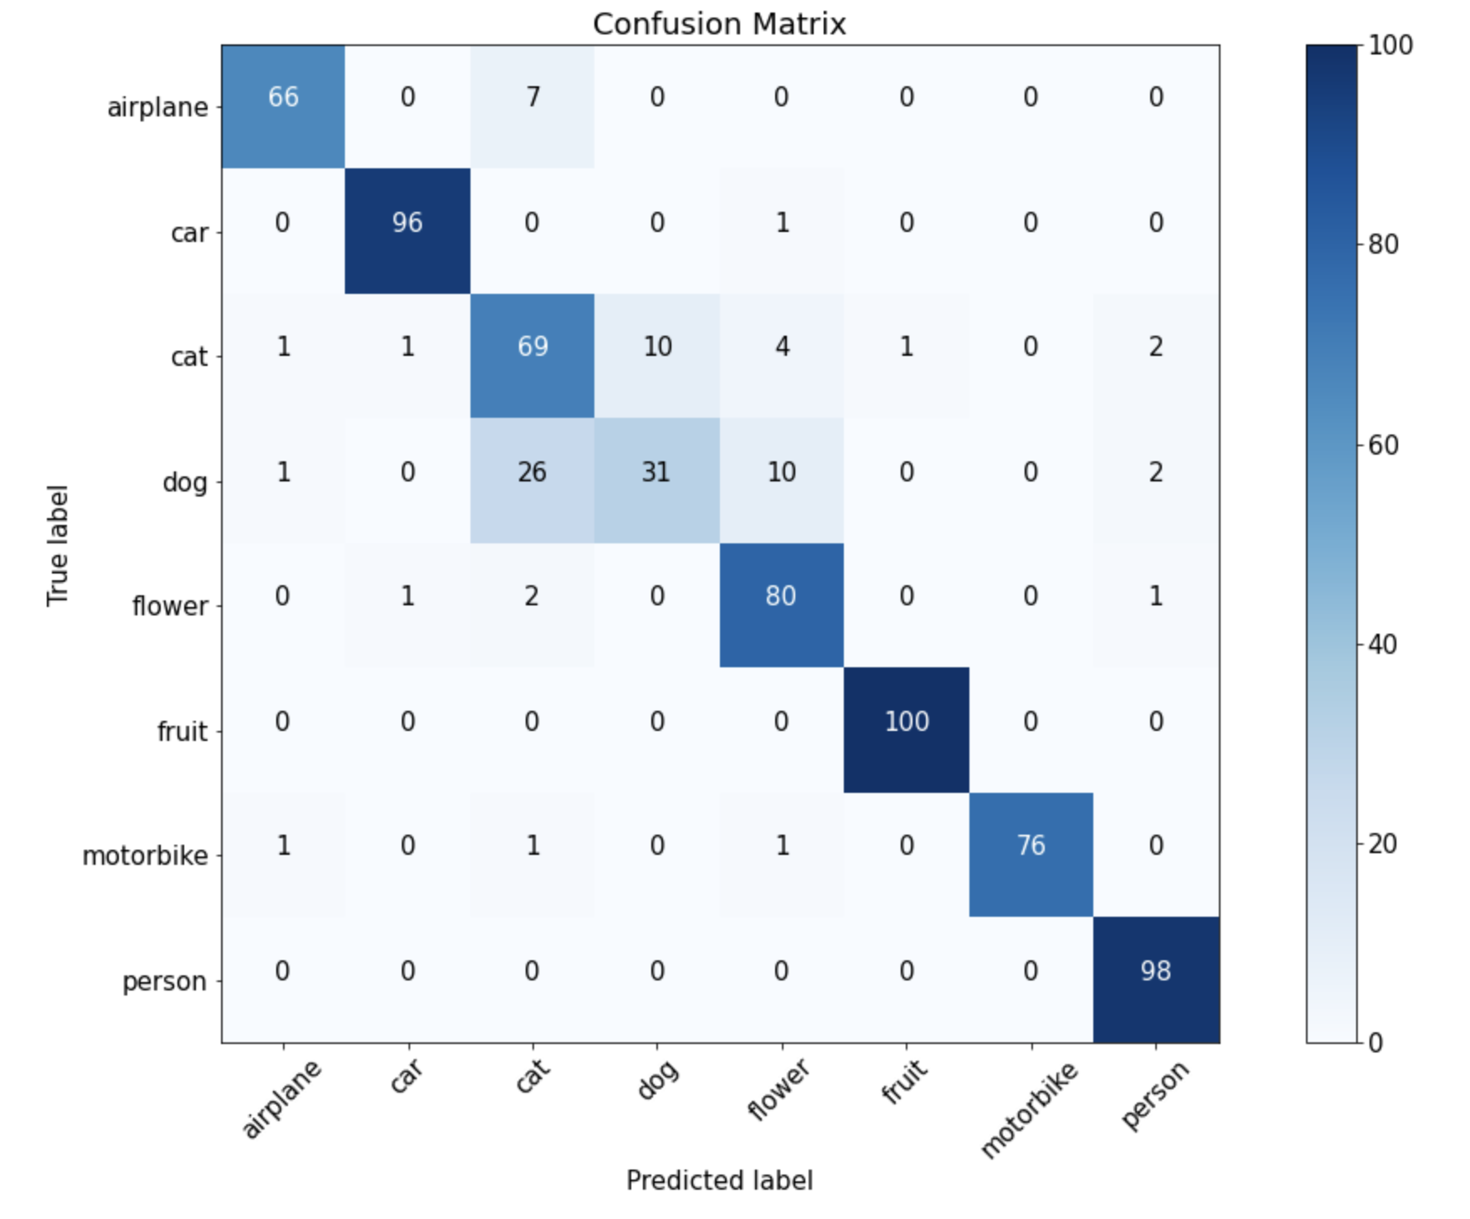
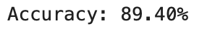
First CNN model
We can see that most of the classes are predicted well, except for class “dog”. This could be improved by tuning some hyperparameters
Accuracy on test set is almost 90%
Natural Images
16

Slide 17
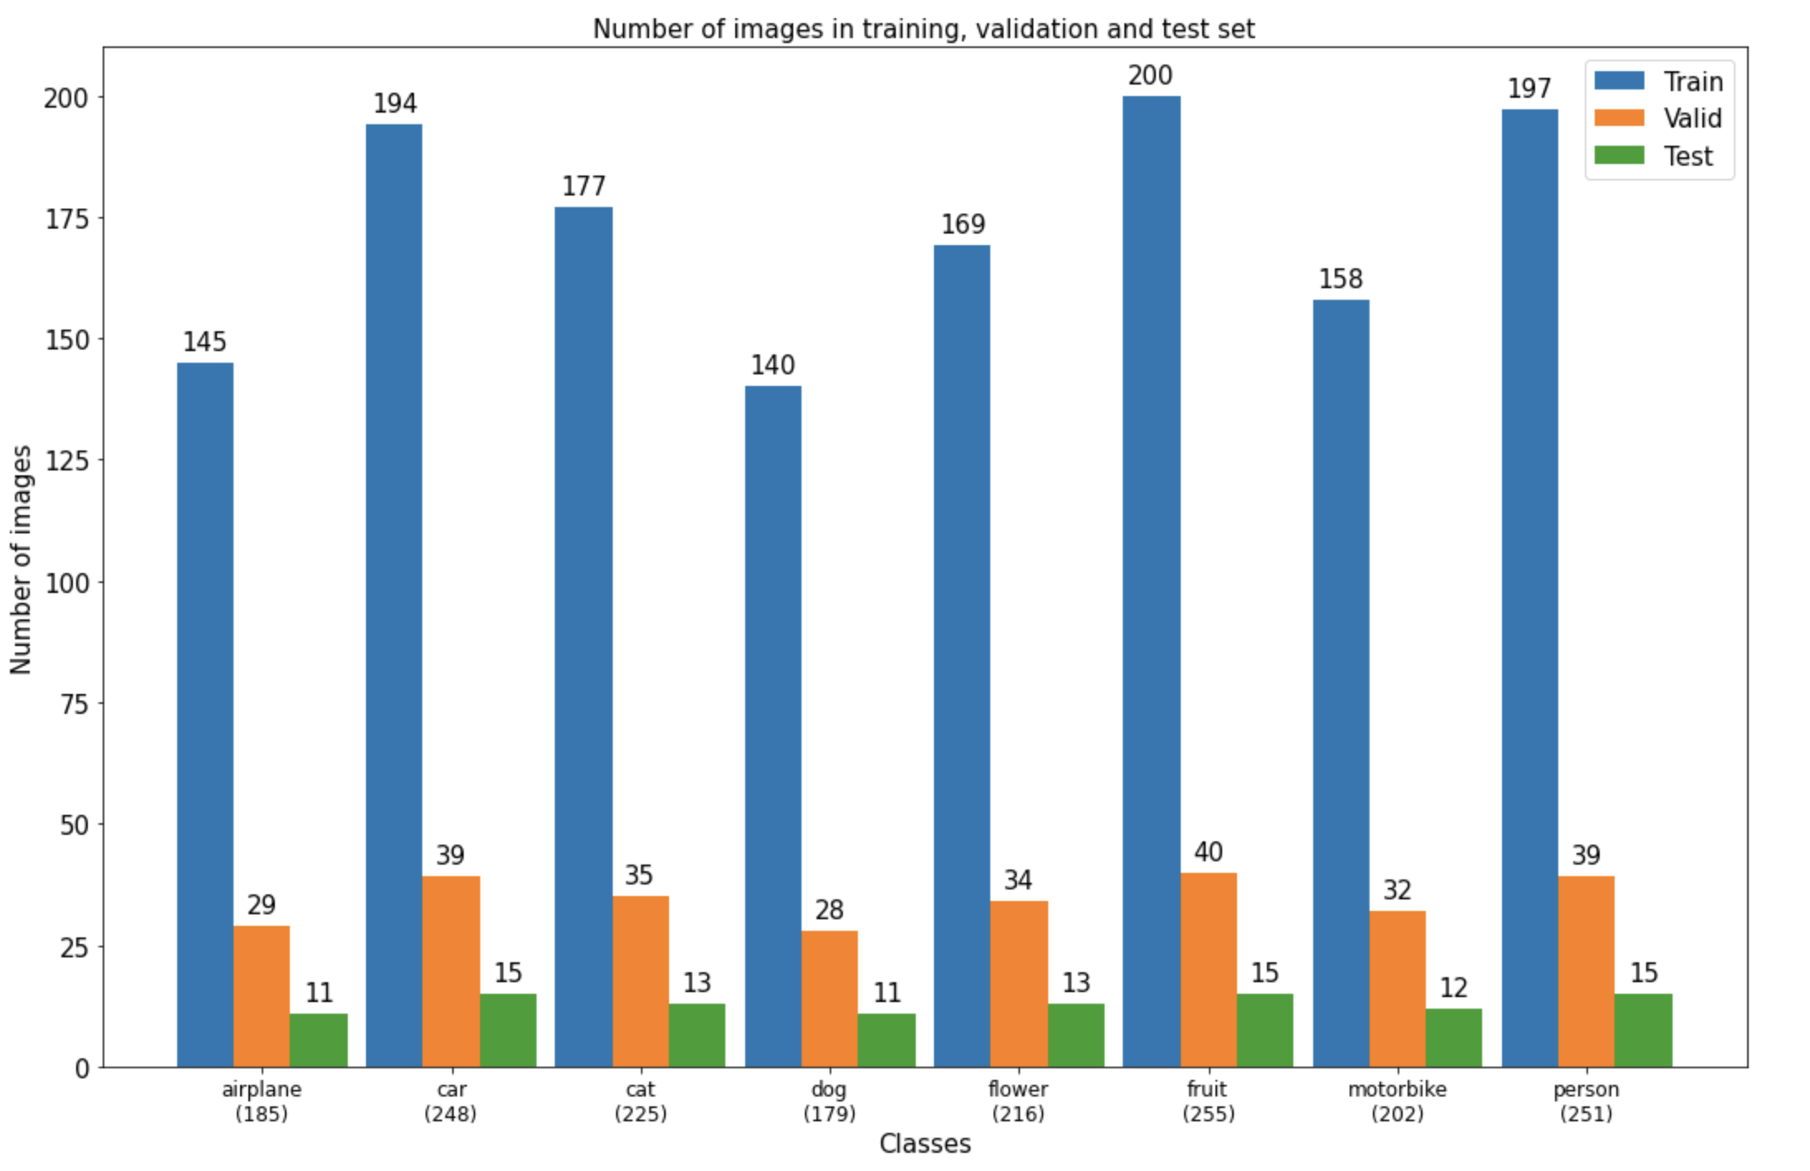
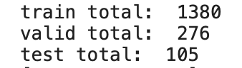
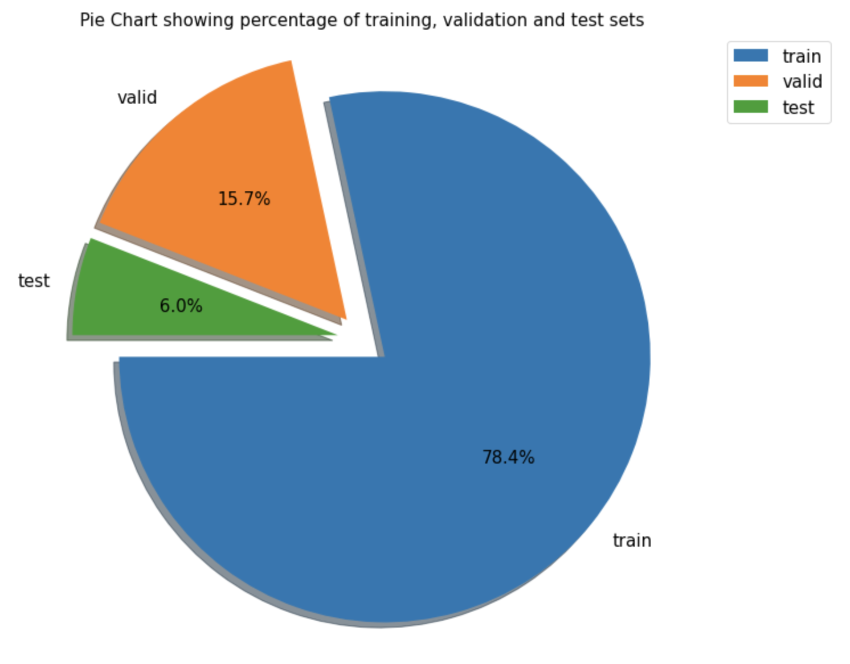
Hyperparameter tuning with small dataset
I have taken a smaller number of images for tuning the hyperparameters
The split between the
training, validation
and test set are almost
like the split earlier
Natural Images
17

Slide 18
Hyperparameter tuning with small dataset
Before tuning hyperparameters, I have created a model with the same architecture as before, but with a smaller dataset.
The major difference between the un-tuned model and the tuned model is the depth of the neural network and the number of filters
This is to check if changing those parameters improves generalization for this dataset
Now I will compare this model with the tuned model.
Natural Images
18

Slide 19
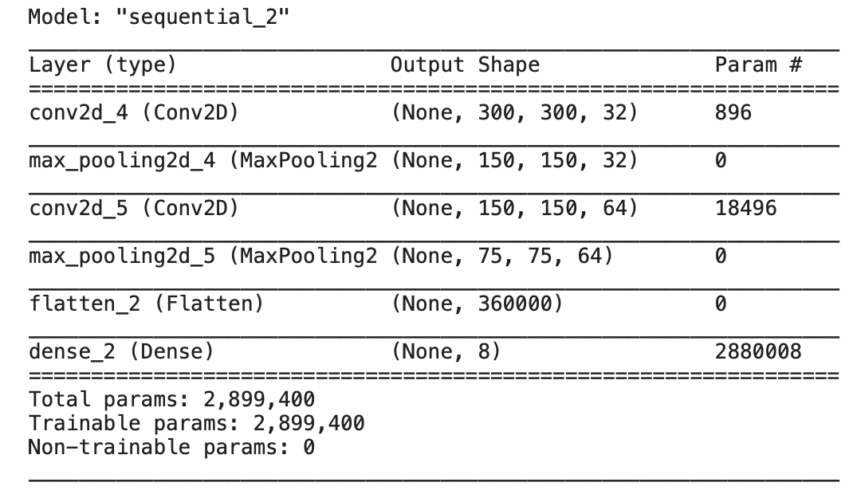
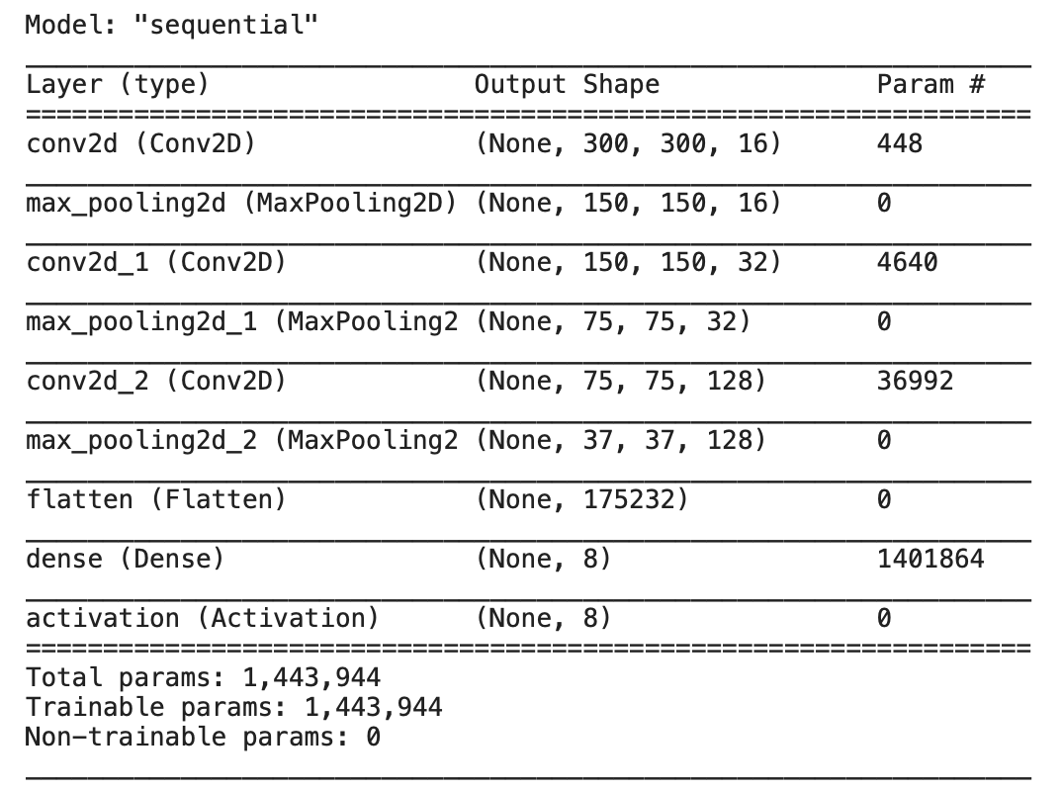
Hyperparameter tuning with small dataset
Model Architecture comparison
Before tuning
After tuning
Natural Images
19

Slide 20
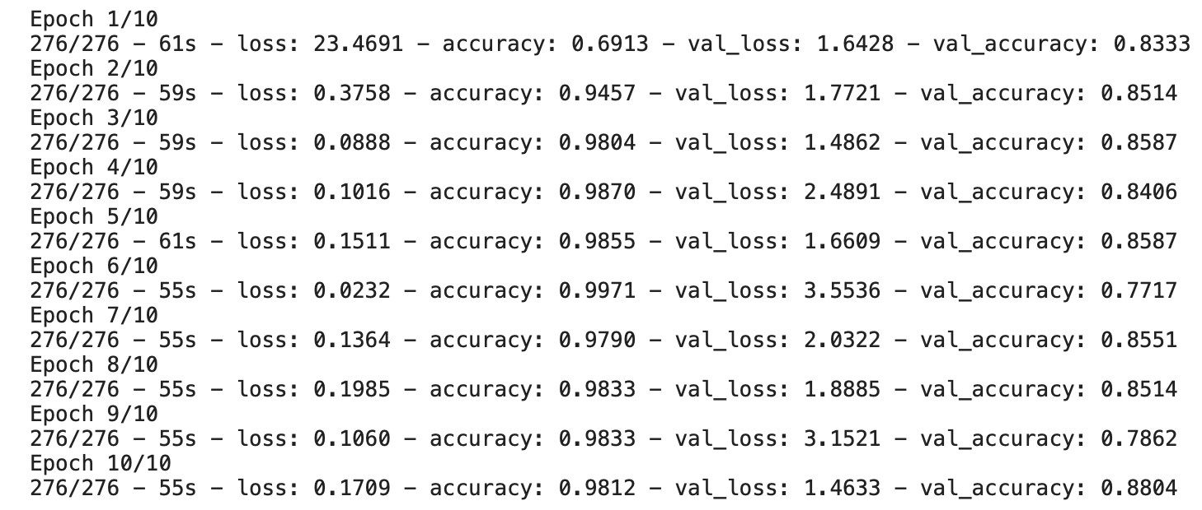
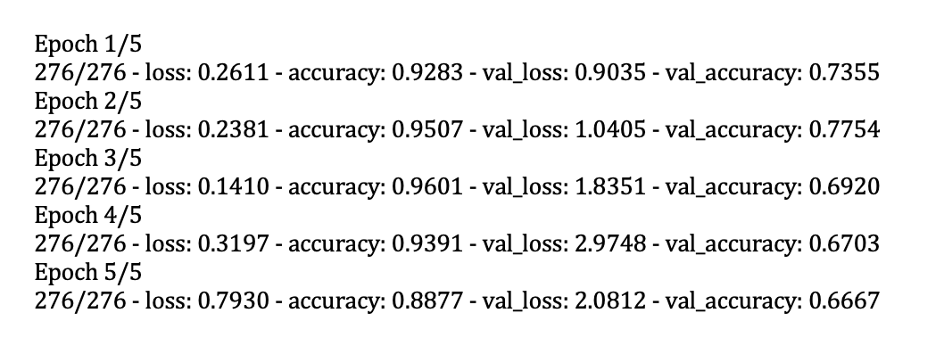
Hyperparameter tuning with small dataset
Train epoch comparison
Before tuning
After tuning
Natural Images
20

Slide 21
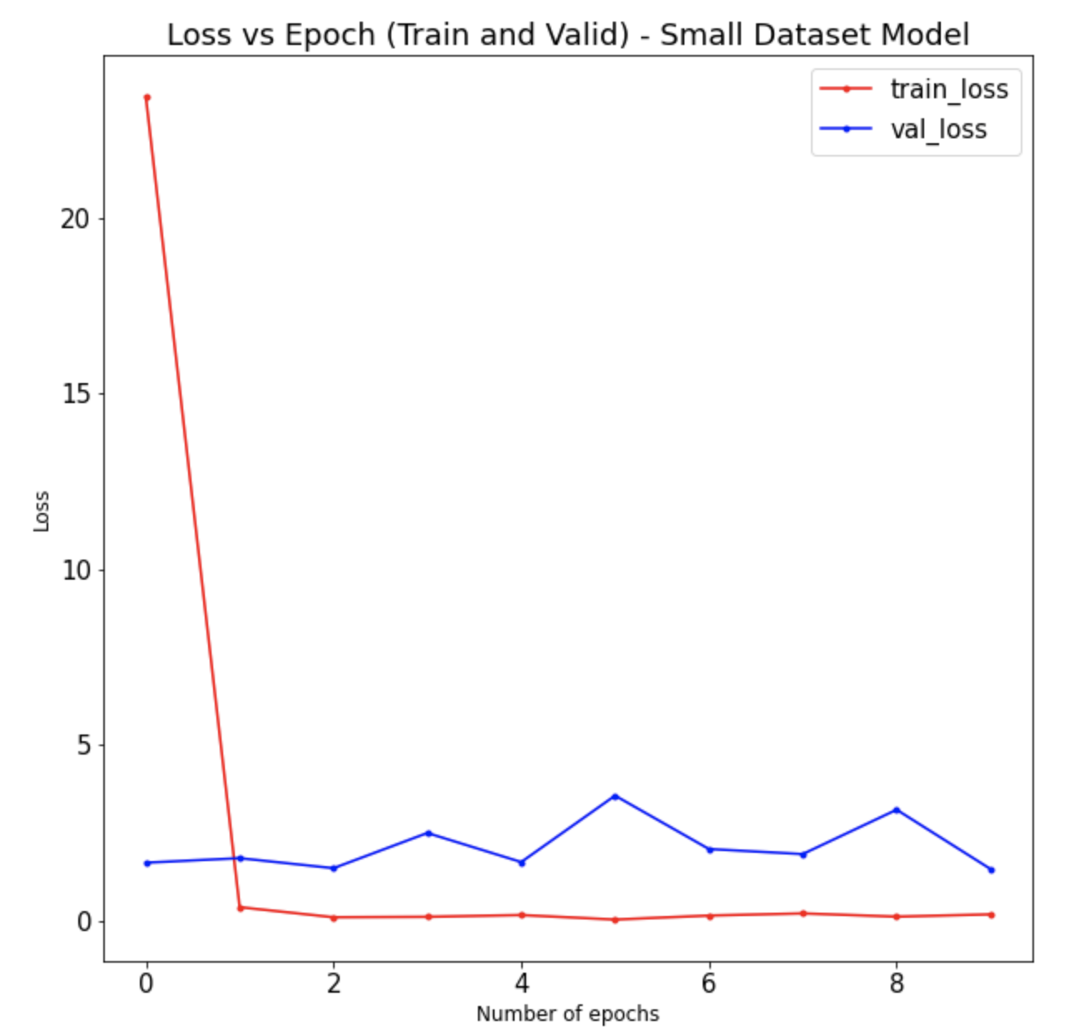
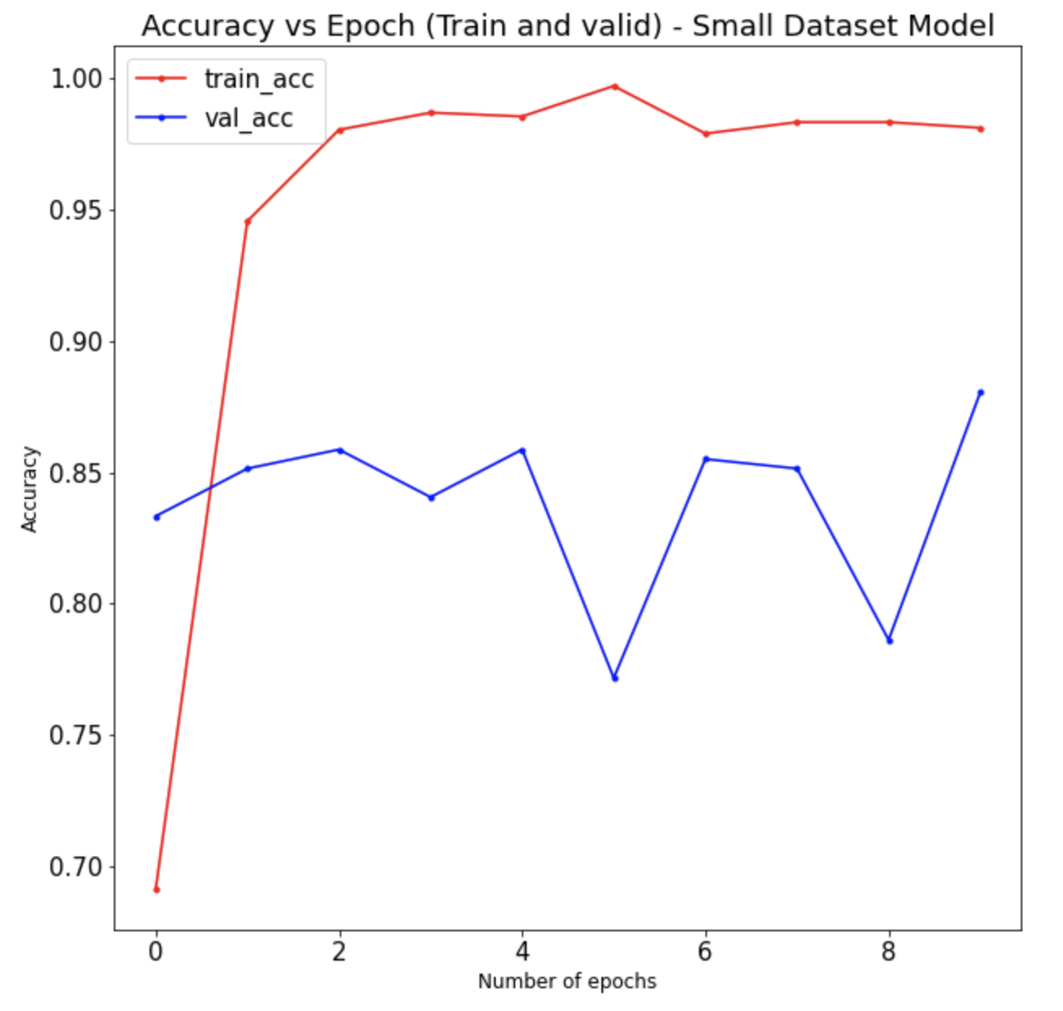
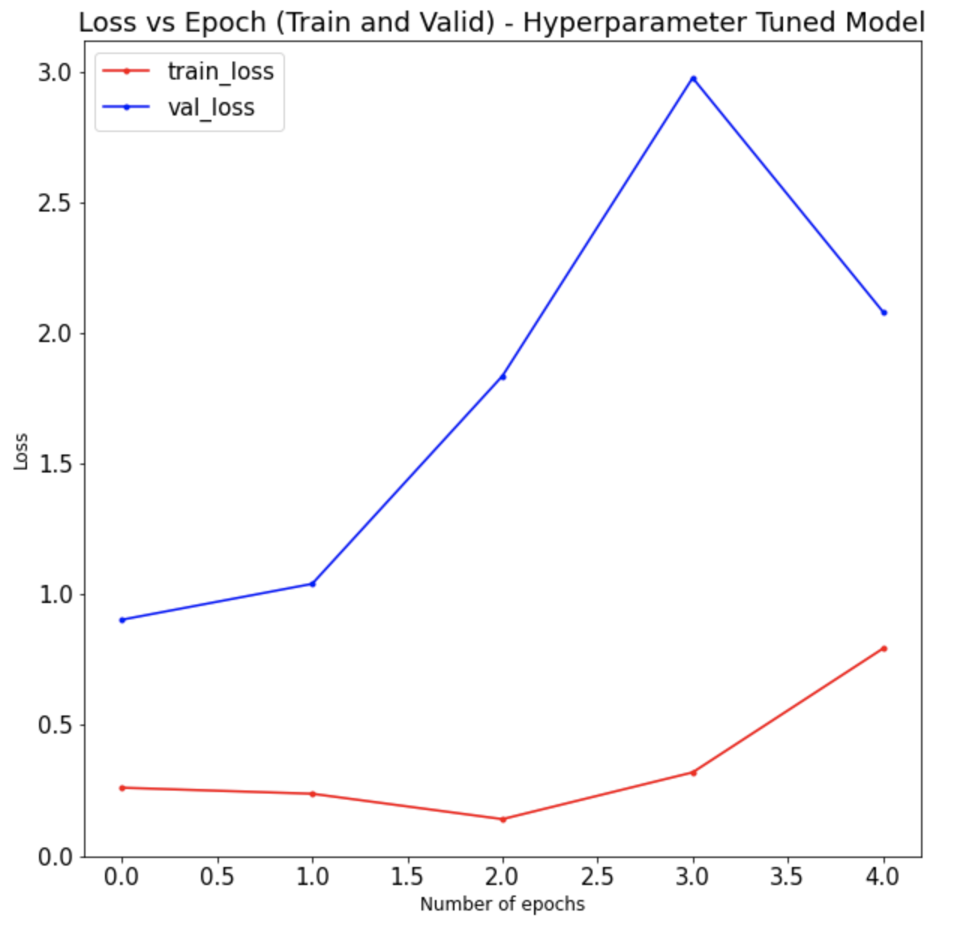
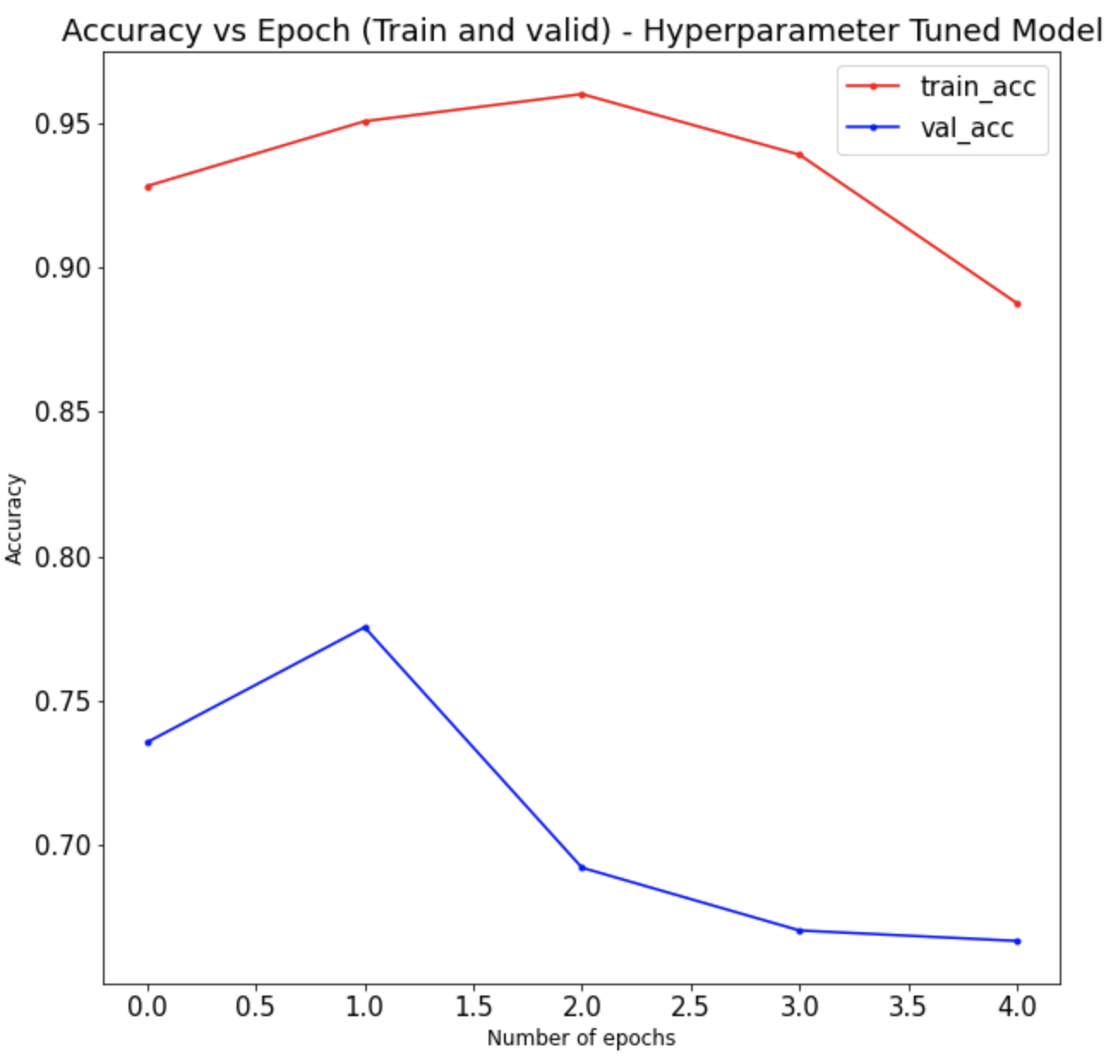
Hyperparameter tuning with small dataset
Loss vs epoch and accuracy vs epoch comparison
Before tuning
After tuning
Natural Images
21

Slide 22
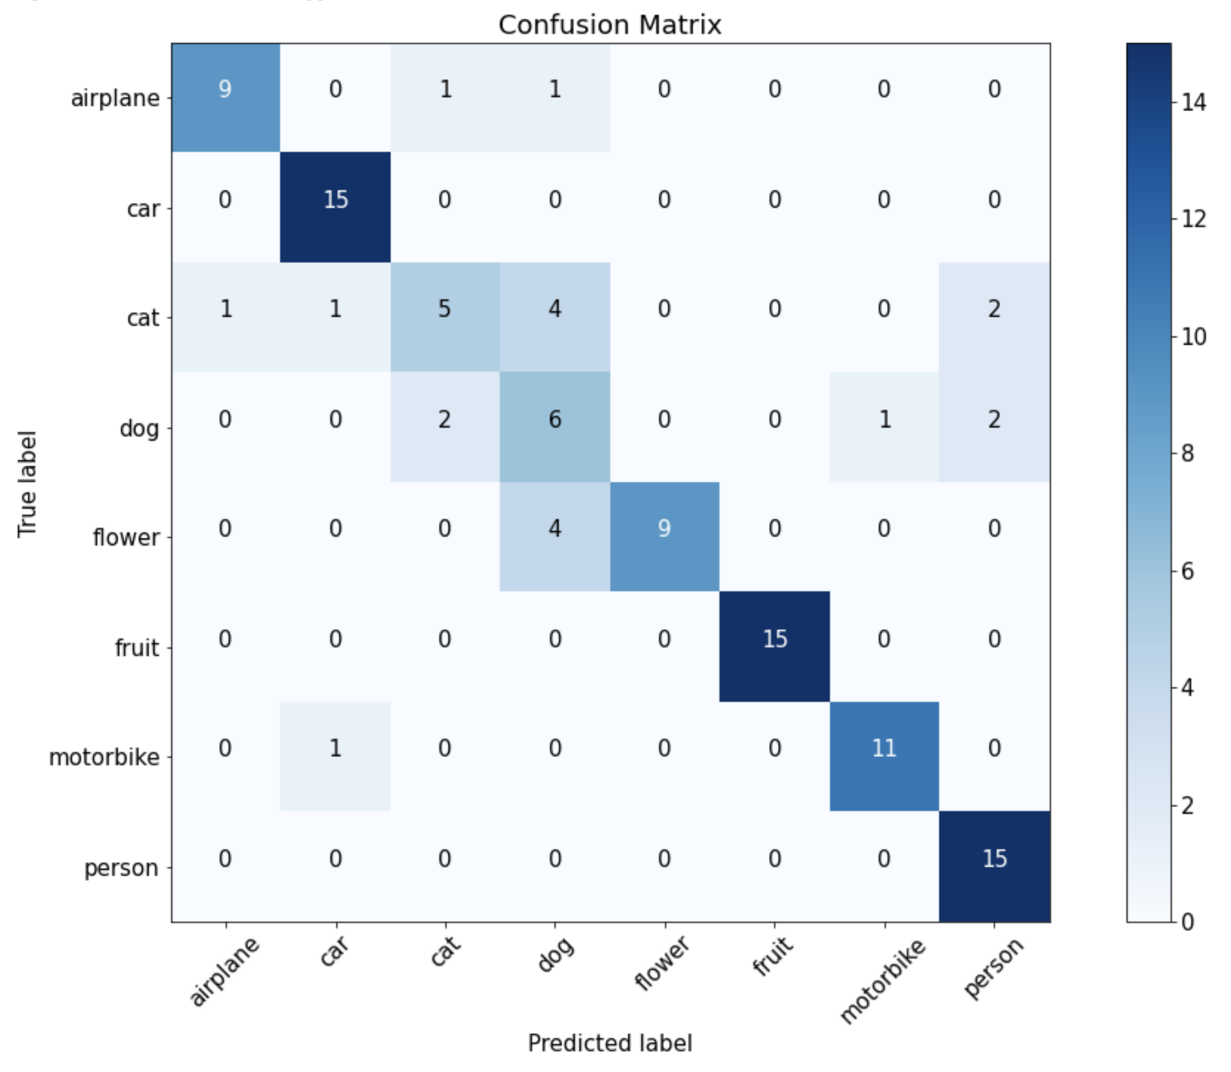
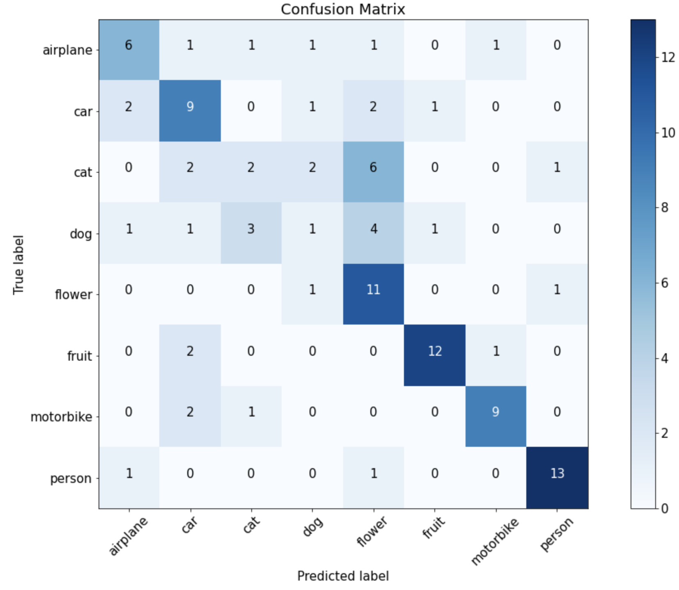
Hyperparameter tuning with small dataset
Confusion matrix comparison
Before tuning
After tuning
Natural Images
22

Slide 23

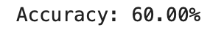
Hyperparameter tuning with small dataset
Test set accuracy comparison
Before tuning
After tuning
Inference:
We can see that creating complex architectures may not always improve a CNN and generalize better
The simple architecture CNN had less loss, better accuracies than the tuned CNN with more layers
Perhaps tuning some other hyperparameters may reduce overfitting
Natural Images
23

Slide 24
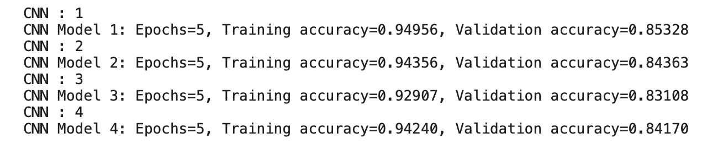
Creating ensembles
I created 4 CNNs, each with 3 Conv2D layers with 32, 64 and 128. filters. I also did batch normalization along with dropout of 0.4
The accuracies can be seen in the image on the left
Then I took a simple average of the 4 models and evaluated the ensembled model
Natural Images
24

Slide 25
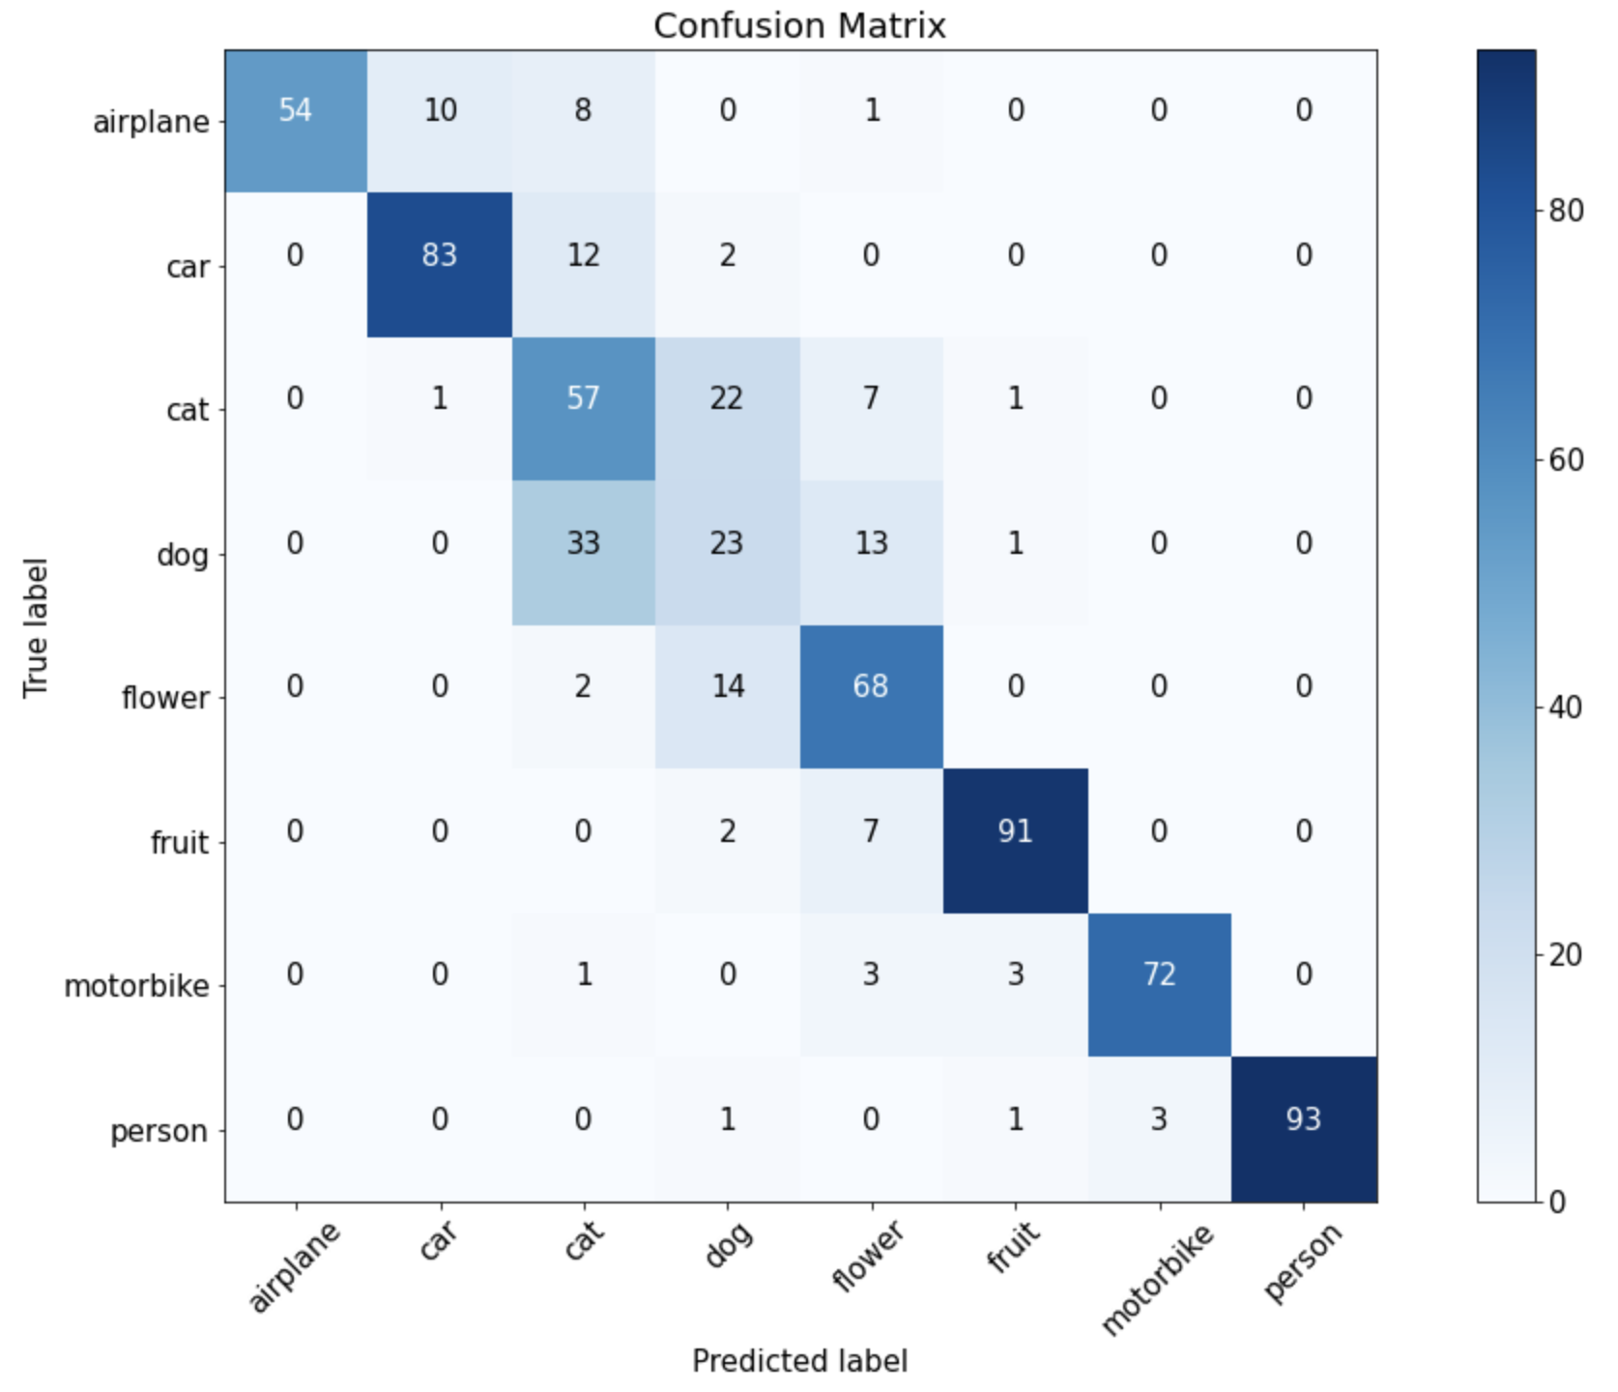
Creating ensembles
The ensemble predicts quite a few false positives and false negatives
The first model that I created performed better than the ensembled model
Perhaps a combination of ensemble of simple models and weighted averaging would provide a better model
The ensemble does not generalize very well as we saw close to 95% accuracy on the train set and over 85% accuracy on the validation set
Natural Images
25

Slide 26
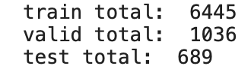
Data augmentation
The above line of code does simple operations like rotation, flip, etc. to an image so that copies can be created in order to increase dataset size
I will now compare the augmented dataset model with the first model that I created
Before augmentation
After augmentation
Natural Images
26

Slide 27
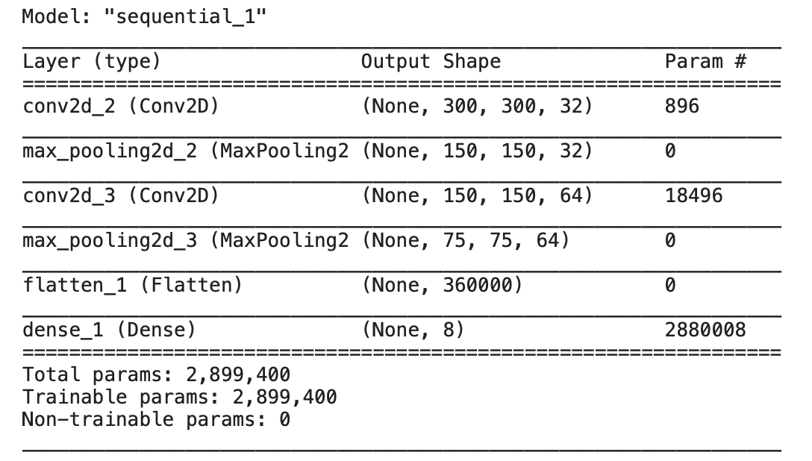
Data augmentation
Model Architecture comparison
Before augmentation
After augmentation
Natural Images
27

Slide 28
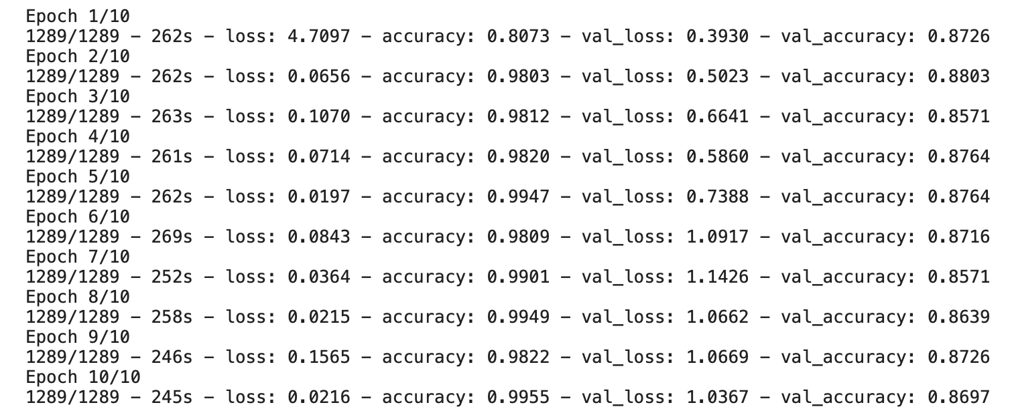
Data augmentation
Train epoch comparison
Before augmentation
After augmentation
Natural Images
28

Slide 29
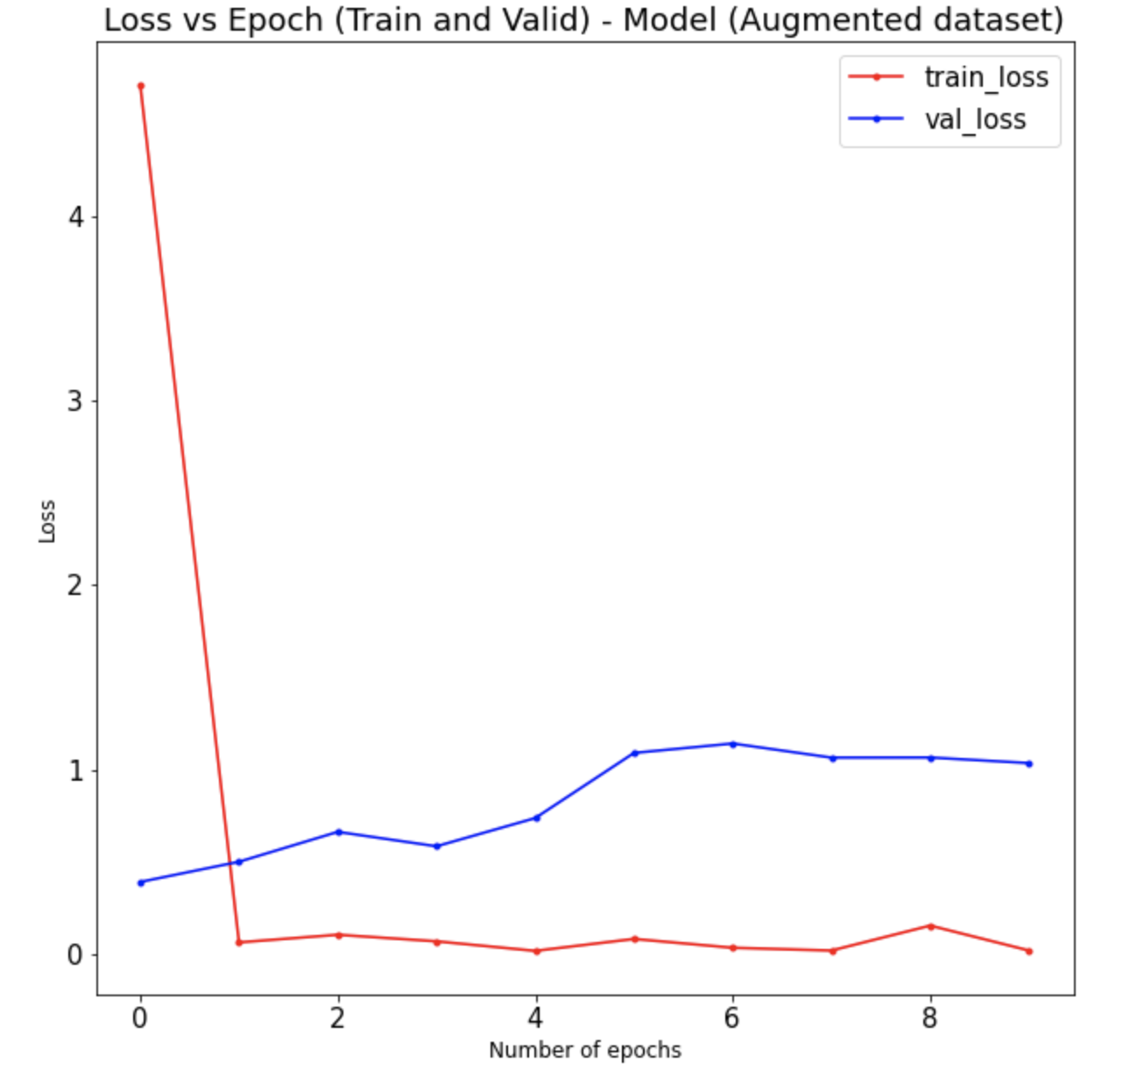
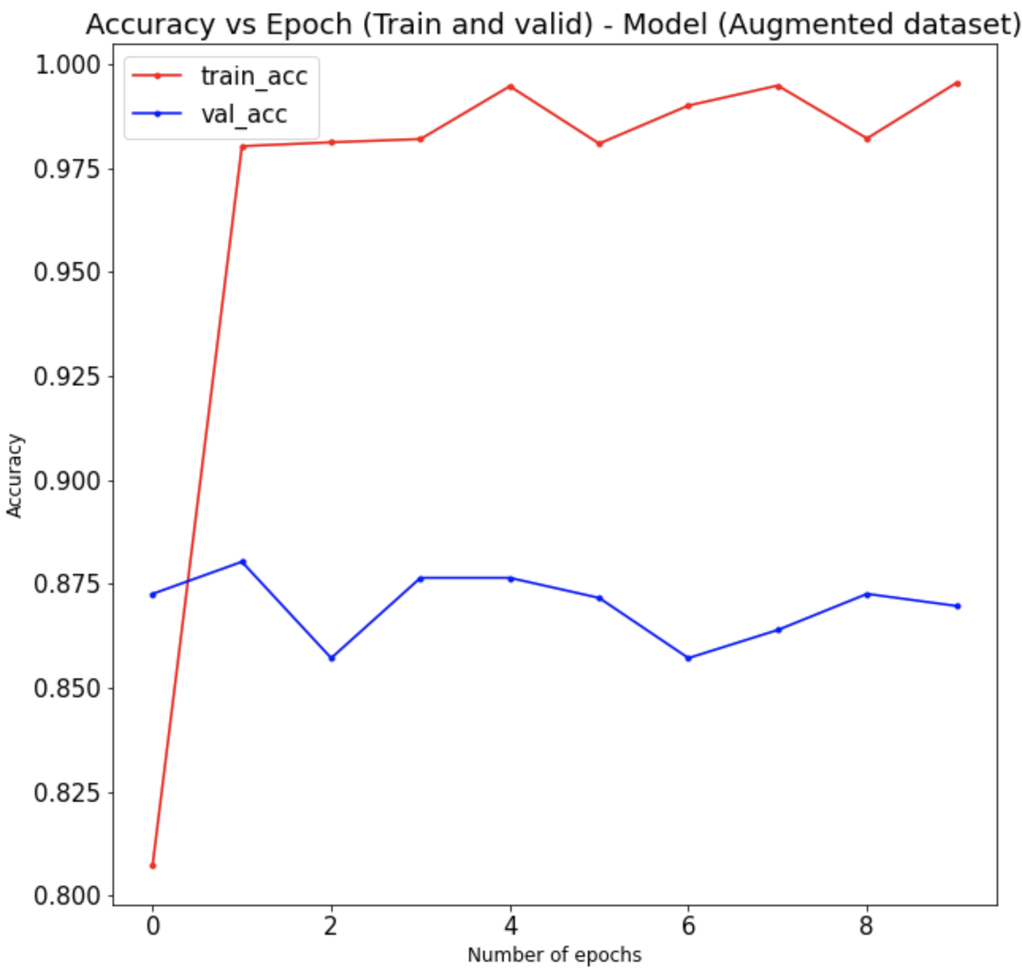
Data augmentation
Loss vs epoch and accuracy vs epoch comparison
Before augmentation
After augmentation
Natural Images
29

Slide 30
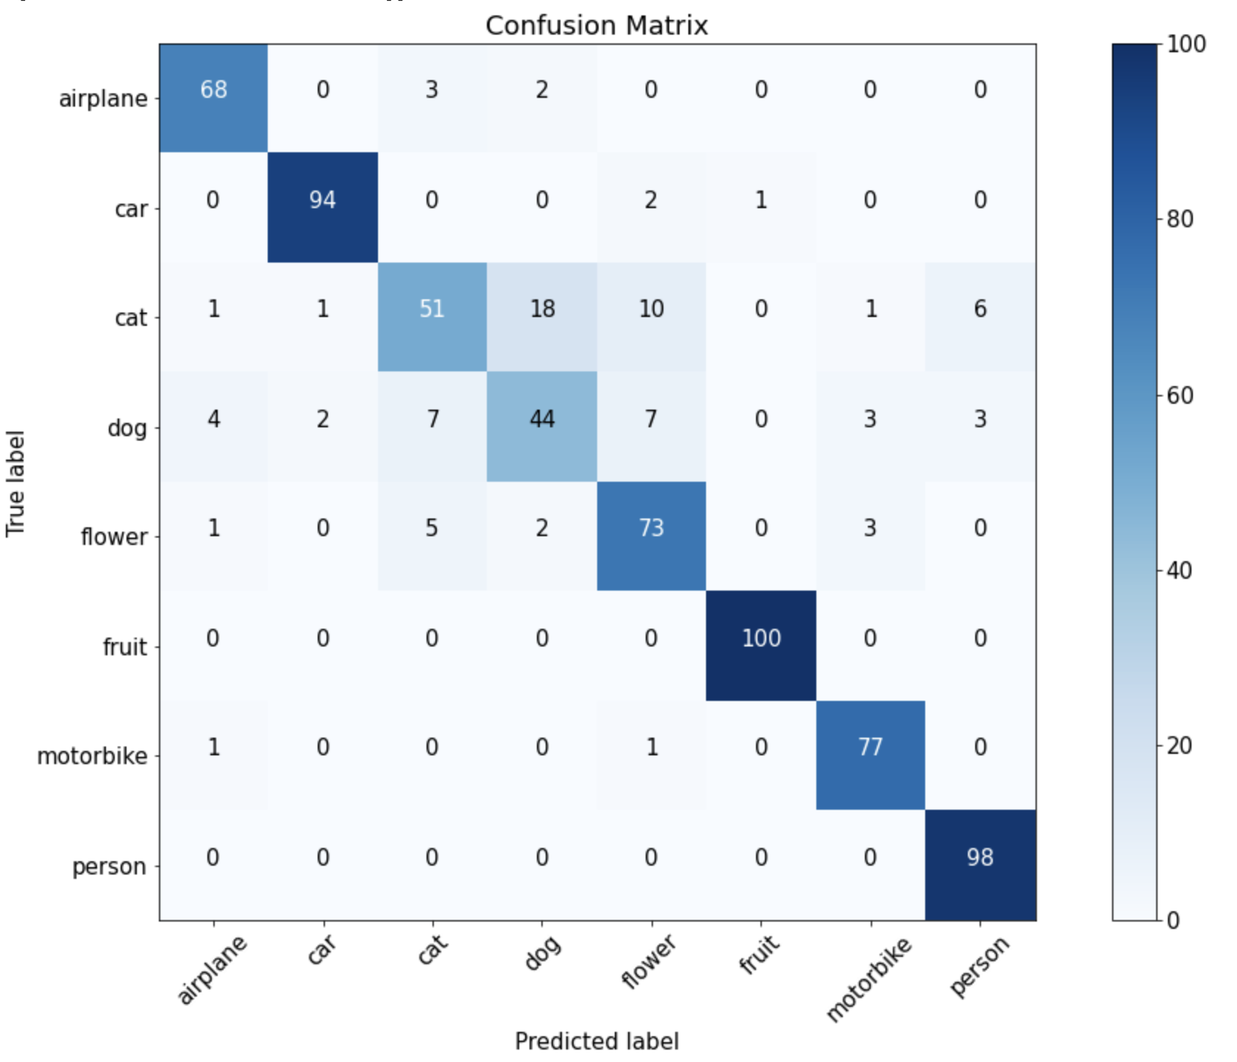
Data augmentation
Confusion matrix comparison
Before augmentation
After augmentation
Natural Images
30

Slide 31
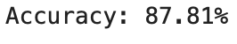
Data augmentation
Test set accuracy comparison
Before augmentation
After augmentation
Inference:
We can see that augmentation did not have a big impact in increasing the accuracy and generalization
Some of the false negatives reduced
The performance is highly dependent on the images which were used for augmentation
Natural Images
31

Slide 32
References
Hassan, Muneeb Ul (2018). VGG16 – Convolutional Network for Classification and Detection. Retrieved from https://neurohive.io/en/popular-networks/vgg16/
Mandy (2019). Convolutional Neural Networks (CNNs) Explained. Extracted from https://deeplizard.com/learn/video/YRhxdVk_sIs
Matplotlib. Grouped bar chart with labels. Retrieved from https://matplotlib.org/3.3.3/gallery/lines_bars_and_markers/barchart.html#sphx-glr-gallery-lines-bars-and-markers-barchart-py
Keras Tuner Documentation. Retrieved from https://keras-team.github.io/keras-tuner/
Julie (2020). Hands on hyperparameter tuning with Keras Tuner. Retrieved from https://www.sicara.ai/blog/hyperparameter-tuning-keras-tuner
Brownlee, Jason (2019). A Gentle Introduction to Batch Normalization for Deep Neural Networks. Retrieved from https://machinelearningmastery.com/batch-normalization-for-training-of-deep-neural-networks/
Ranjan, Chitta (2019) Understanding Dropout with the Simplified Math behind it. Retrieved from https://towardsdatascience.com/simplified-math-behind-dropout-in-deep-learning-6d50f3f47275
Dr. Kumar, Vaibhav (2020). Hands-on Guide To Create Ensemble Of Convolutional Neural Networks. Retrieved from https://analyticsindiamag.com/hands-on-guide-to-create-ensemble-of-convolutional-neural-networks/
Ruizendaal, Ruger (2017). Deep Learning #3: More on CNNs & Handling Overfitting. Retrieved from https://towardsdatascience.com/deep-learning-3-more-on-cnns-handling-overfitting-2bd5d99abe5d
Natural Images
32

